Slide 1
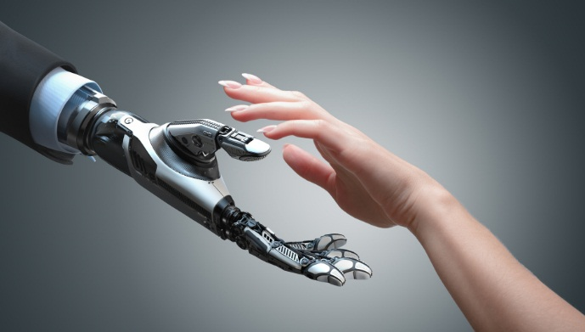
Robots, Ethics
and the Future of Jobs
Chapter 1 - Introduction
Sean McDonagh, SSC

Slide 2
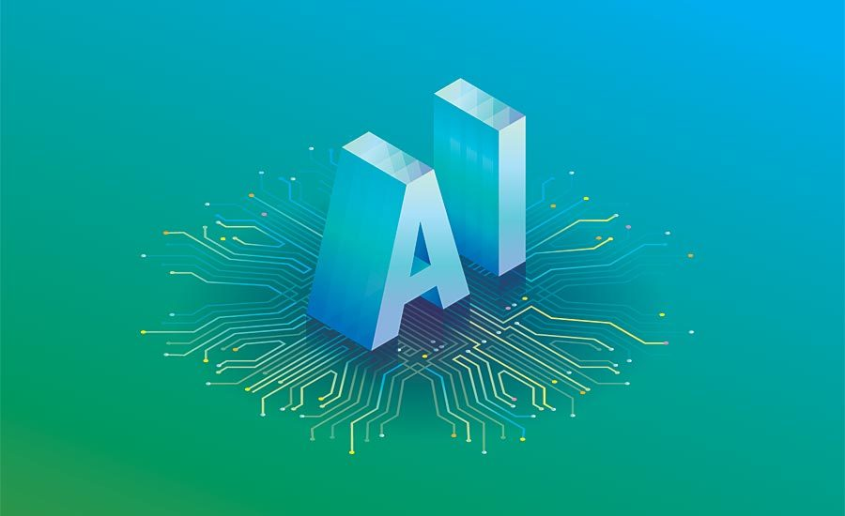
Artificial Intelligence Technologies
in the Last Forty Years

Slide 3
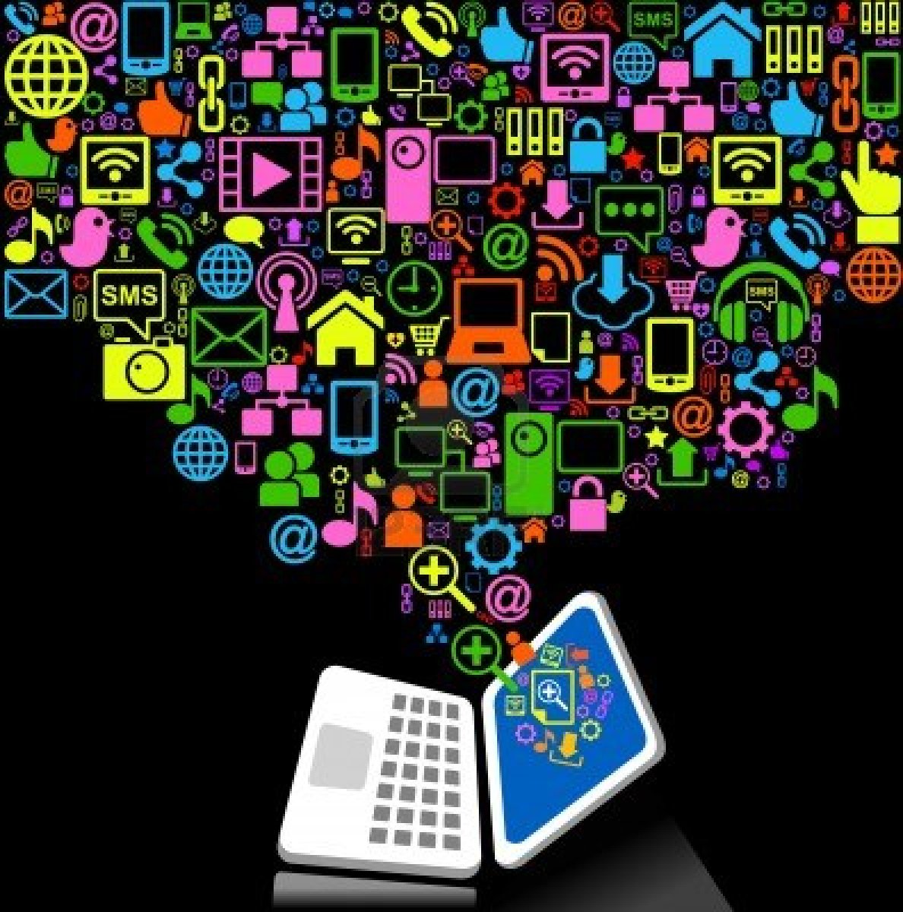
Unbelievable strides in computer and communication technologies

Slide 4
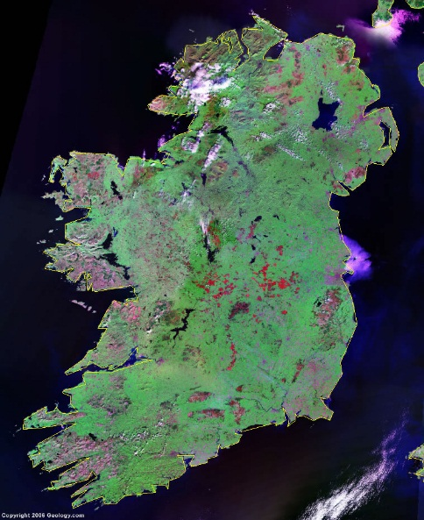
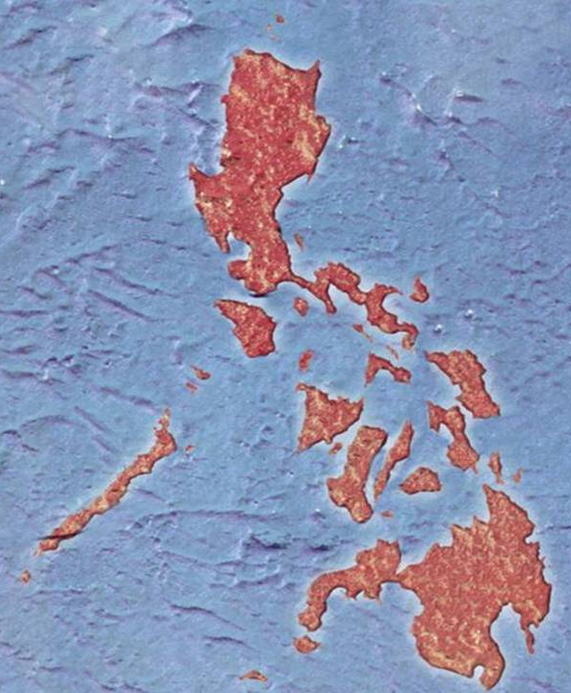
Philippines,
late 1970’s:
To place a call from Mindanao to Ireland

Slide 5
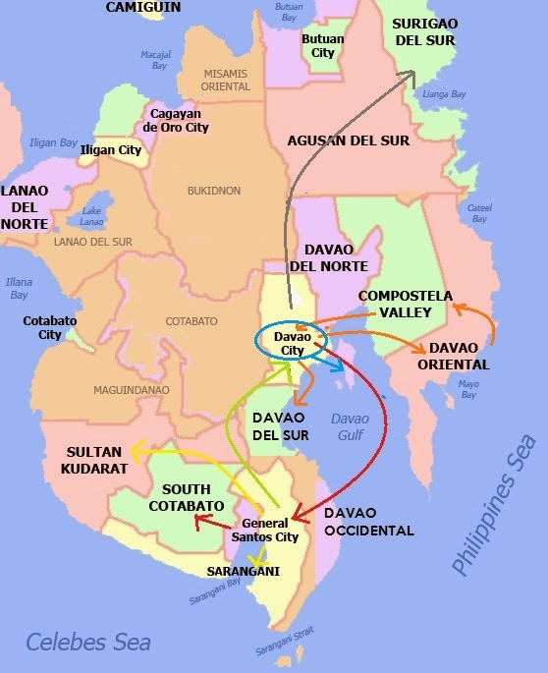
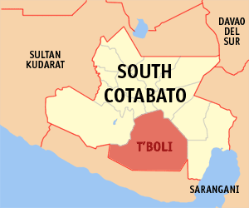
From T’Boli town in South Cotabato
to Davao City, the only place on the island with international telephone connection.

Slide 6
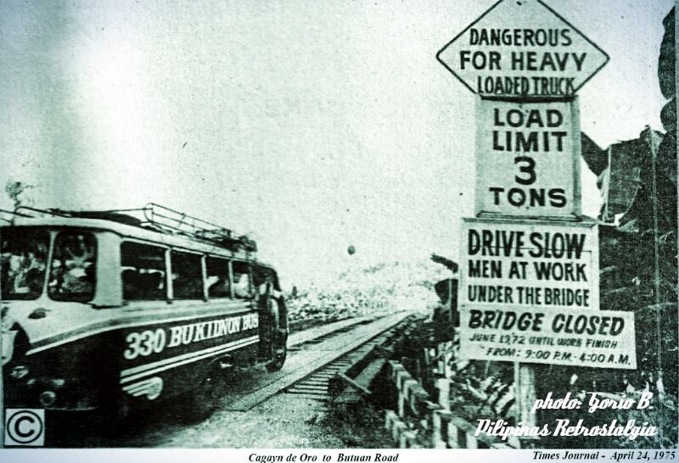
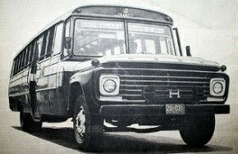
4-6 hours bus journey depending on the condition of the road and the bus.

Slide 7
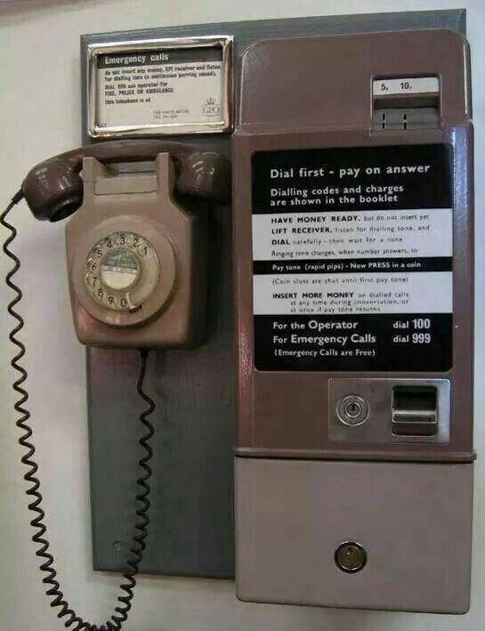
Davao City: At the overseas telephone centre, book a call for ten minutes but, often after 4-5 minutes, connection breaks down, and frequently, can’t be restored.

Slide 8
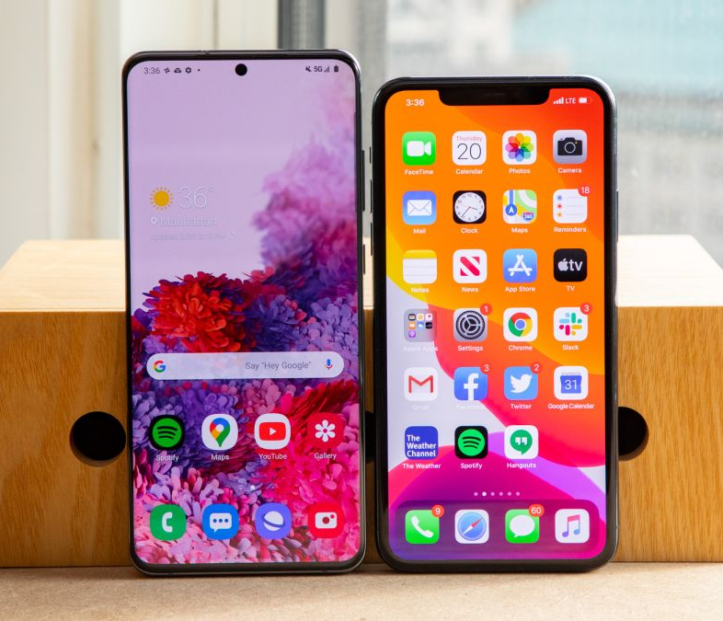
Contrast the effort, drudgery and time it took to make that call with the speed and ease of reaching people globally today.

Slide 9
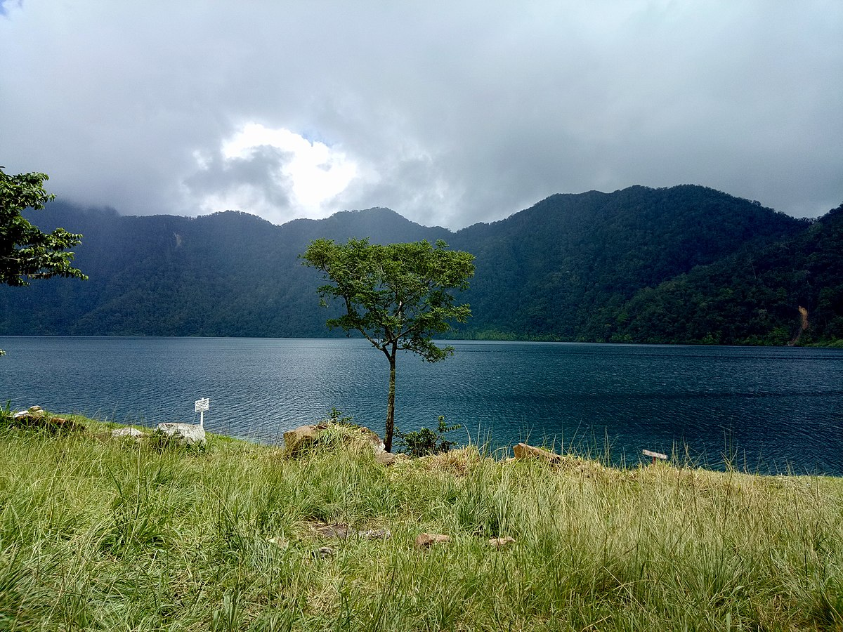
Now it is possible to phone, text, Skype or email people in Lake Sebu.
Many T’Bolis have Facebook accounts or use other social media platforms.

Slide 10
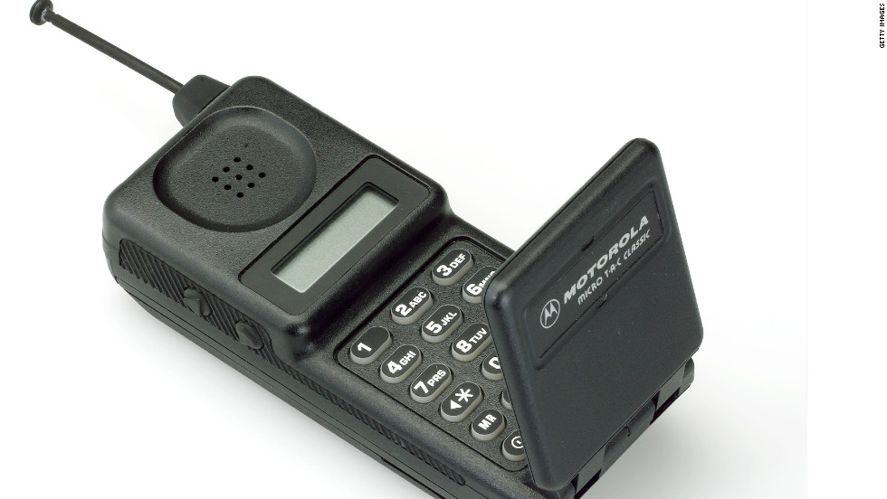
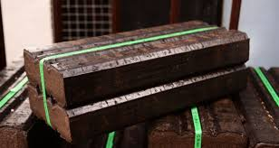
The First Time I Saw a Mobile Phone
Hong Kong in the early 1980s. The device looked like a large Bord Na Mona turf briquette and the battery, which was huge, lasted for less than an hour.

Slide 11
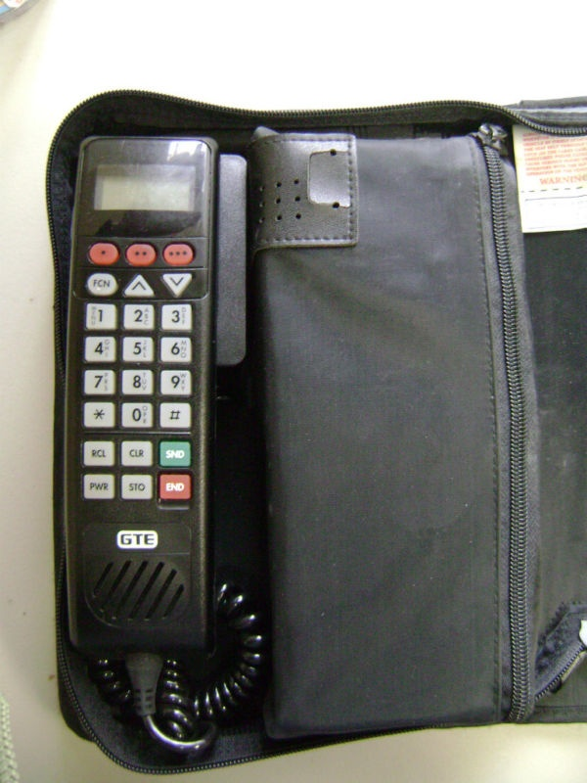
I did not think that this technology would become commonplace and be a central part of global communication technology in the future.

Slide 12
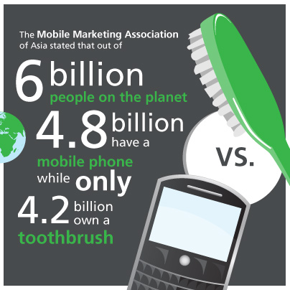
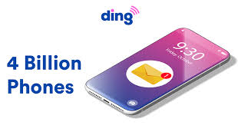
In 2020, there are more than four billion phones being used across the globe today.

Slide 13
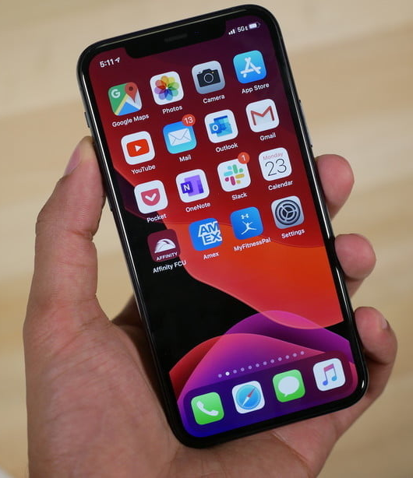
Making a global phone call today can be achieved in just a few minutes.

Slide 14
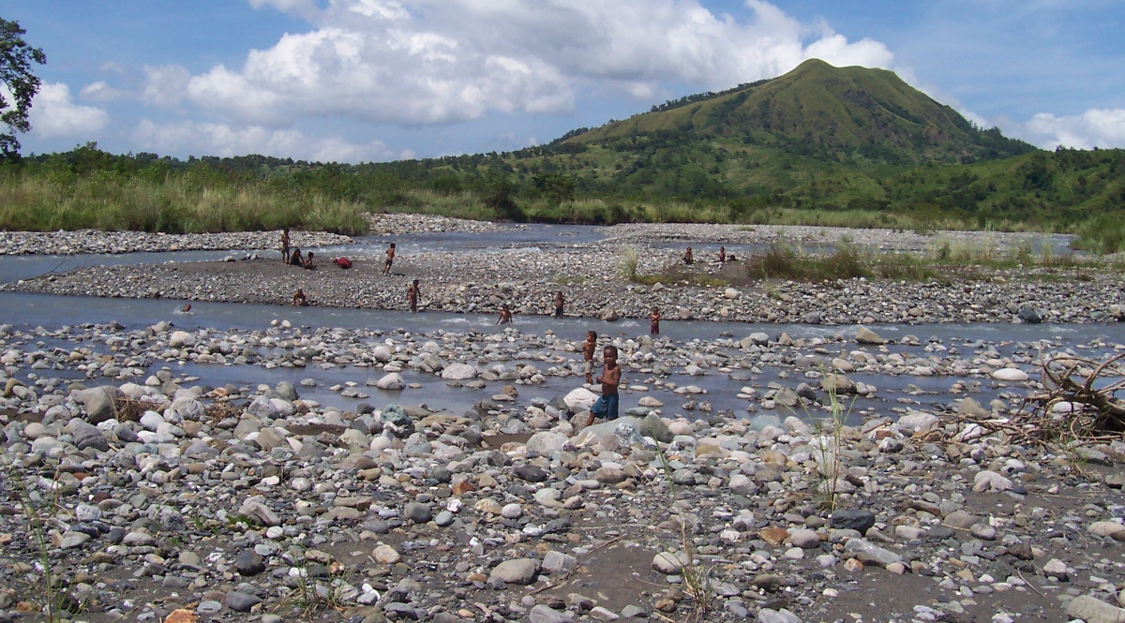
Tagaytay near Manila, January 1988: Meeting with Philippine Bishops to approve the Pastoral Letter on the Care of the Earth which I helped to draft.
What Is Happening
to our Beautiful Land?

Slide 15
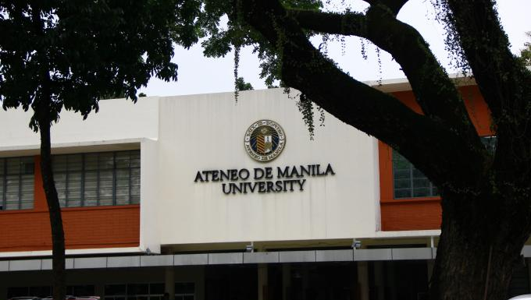
My attention was drawn to an incorrect reference cited in the document. To correct that mistake, I had to take a bus from Tagaytay to the Jesuit university in Manila, to check the reference.

Slide 16
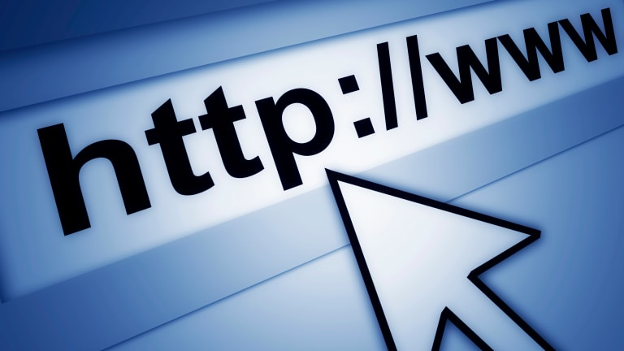
Correcting one citation took me a day and a half. If I had access to the internet at that time, I could have amended the text in two or three minutes.

Slide 17
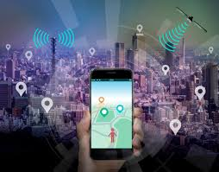
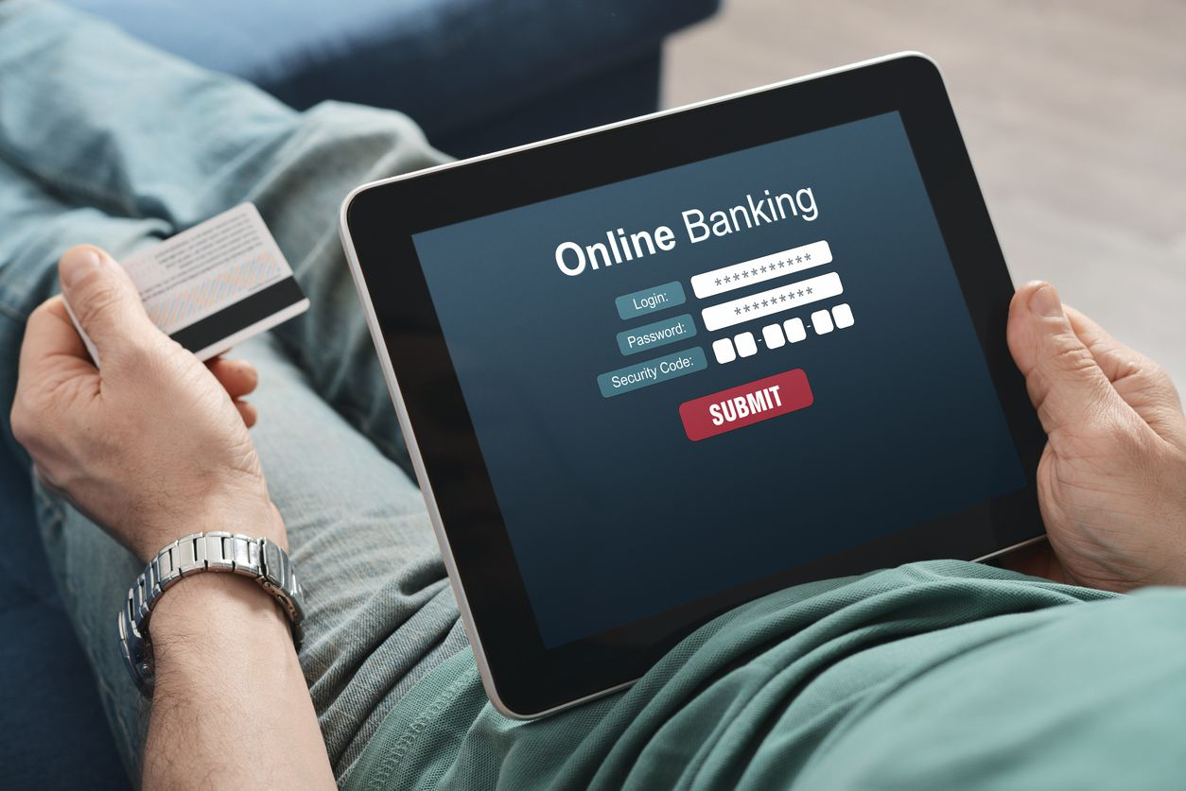
With a mobile phone, I can
send email to people right across the world
surf the internet
do web banking
play games,
listen to my favourite music

Slide 18
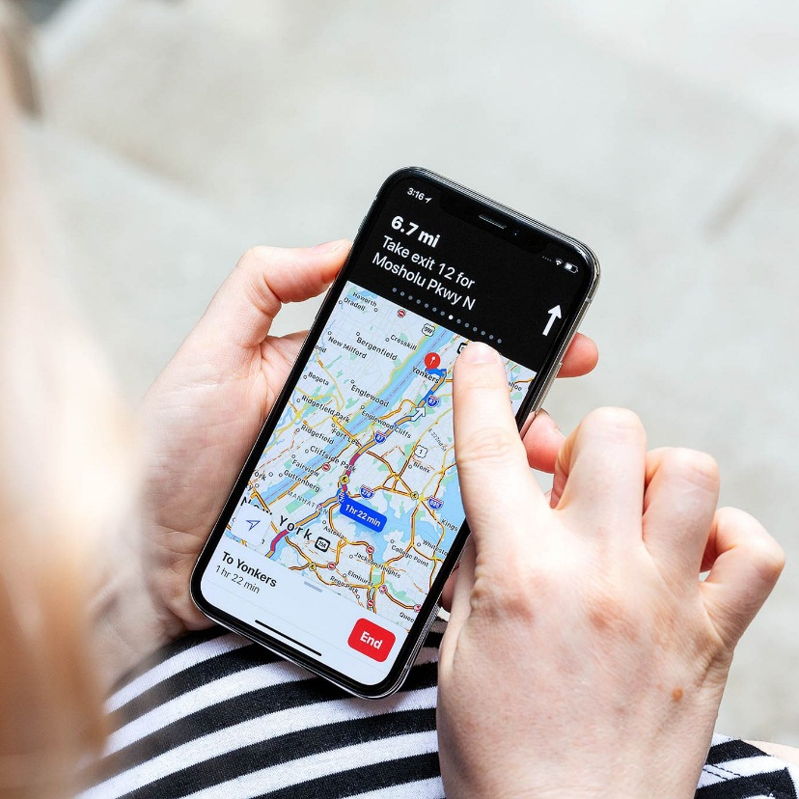
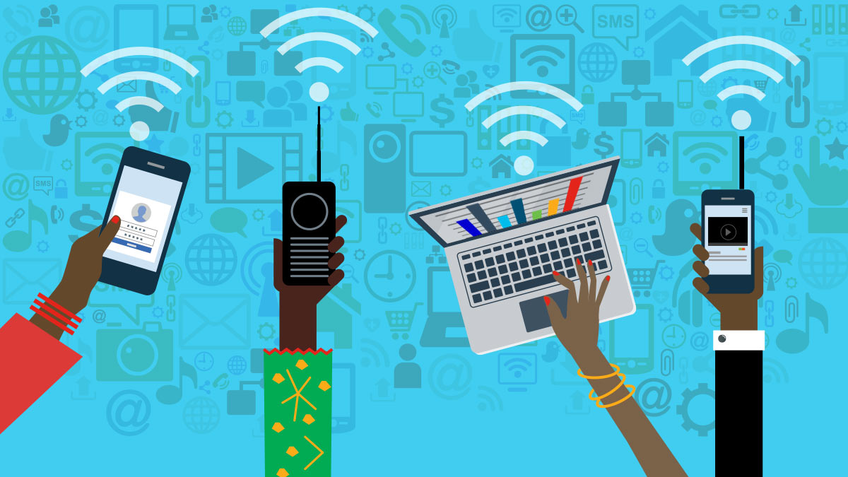
use a GPS (Global Positioning System)
locate addresses across the world
watch all kinds of videos
check for current news items
Etc…etc….

Slide 19
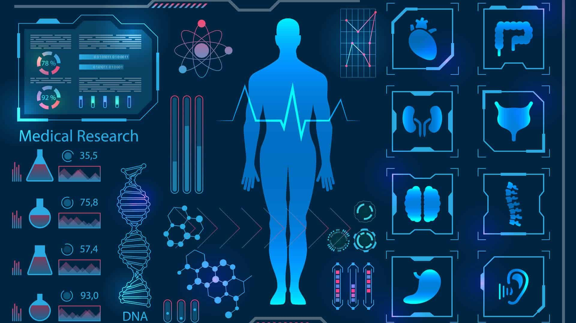
Artificial Intelligence and Medicine

Slide 20
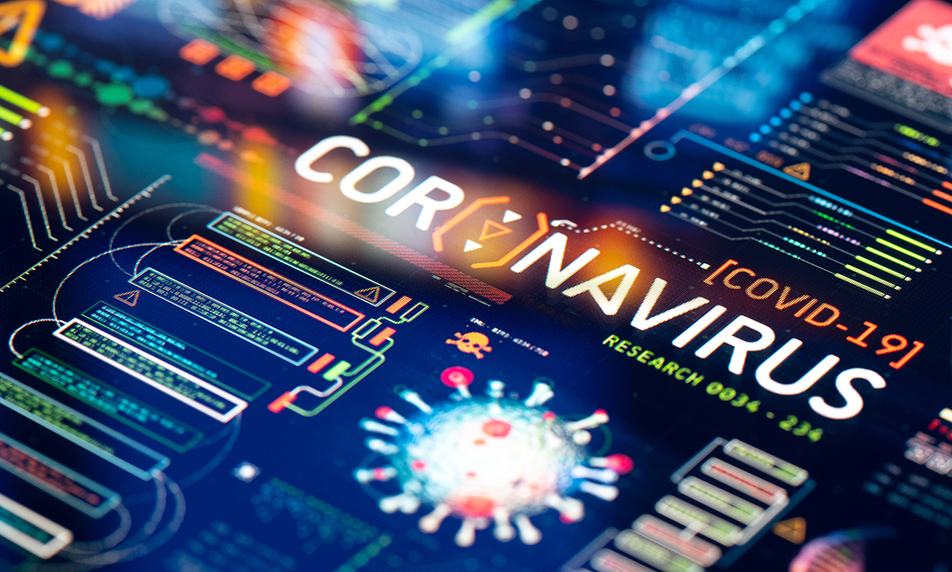
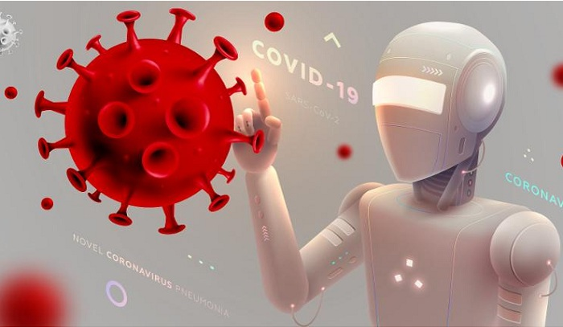
In 2020, researchers are using artificial intelligence (AI) to understand the coronavirus more thoroughly and to find drugs that can fight it or create a vaccine.

Slide 21
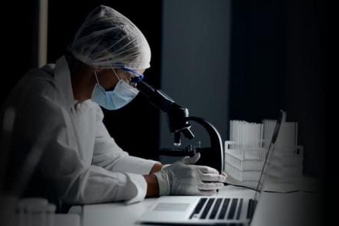
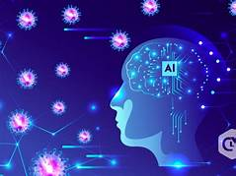
February 2020: researchers at the London start-up, Benevolent AI, use machine-learning algorithms to identify a drug that could fight Covid-19.

Slide 22
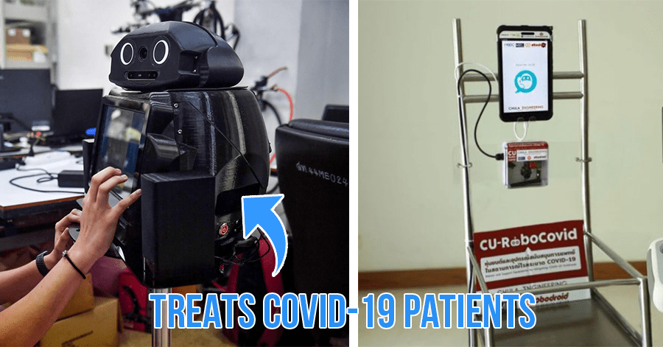
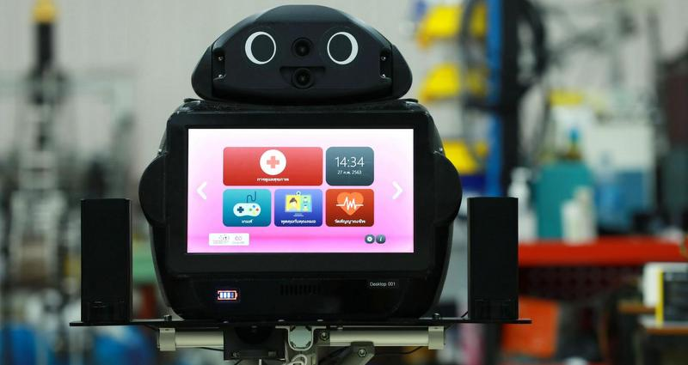
Thailand: Hospitals deploy 'ninja robots' to measure the fever level of corona virus patients to protect the health of medical workers on the frontlines.

Slide 23
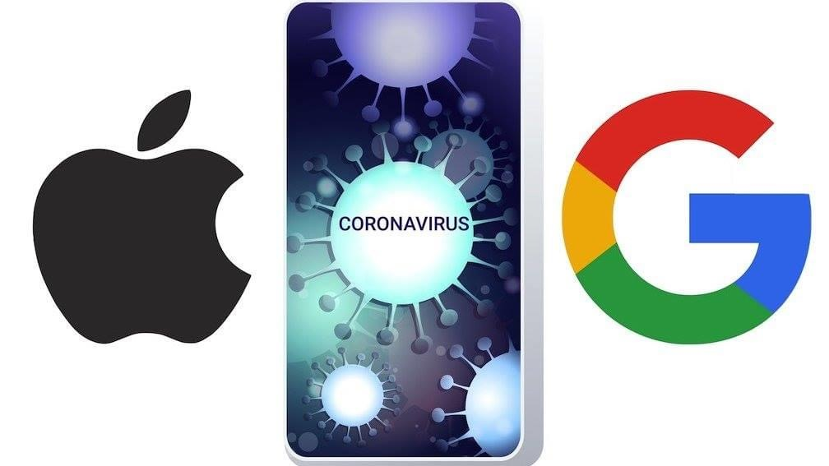
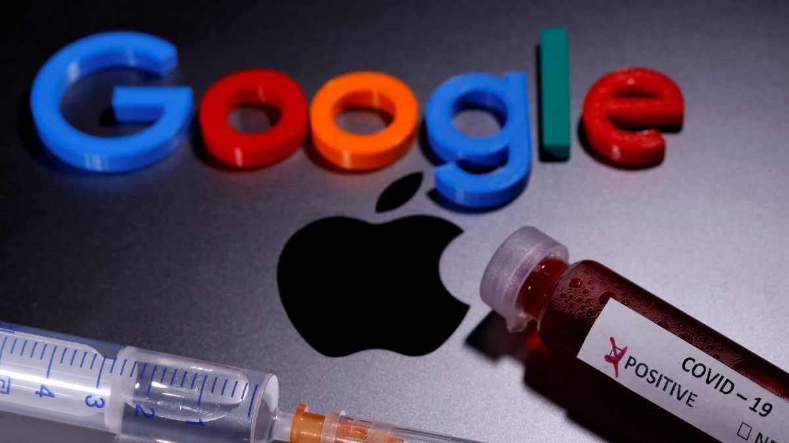
Apple and Google announced that they would use their sophisticated technology to trace people (who) may be infected with Covid-19.

Slide 24
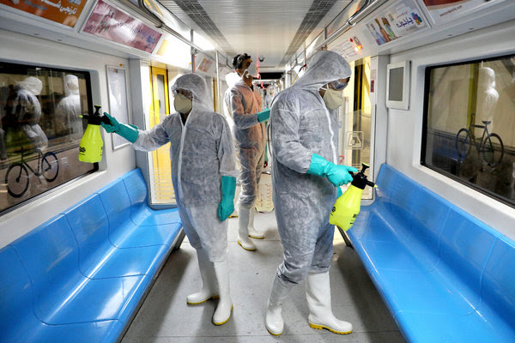
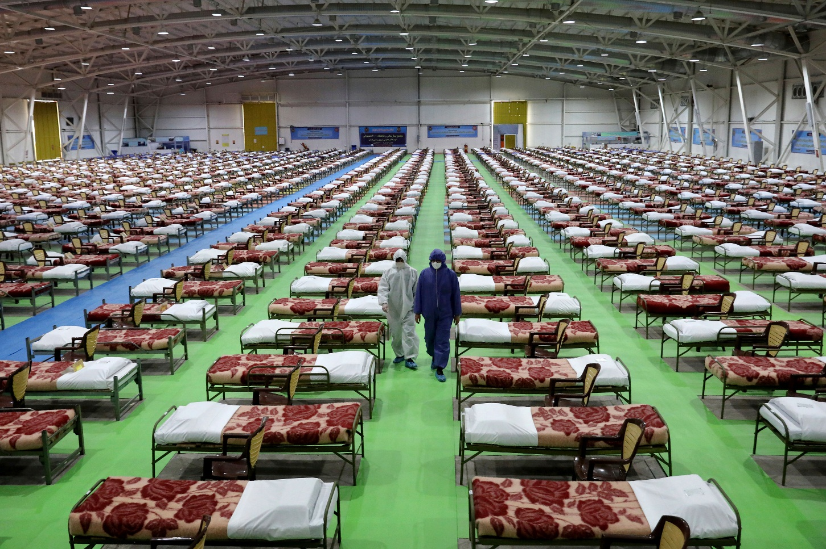
very admirable during a pandemic crisis

Slide 25
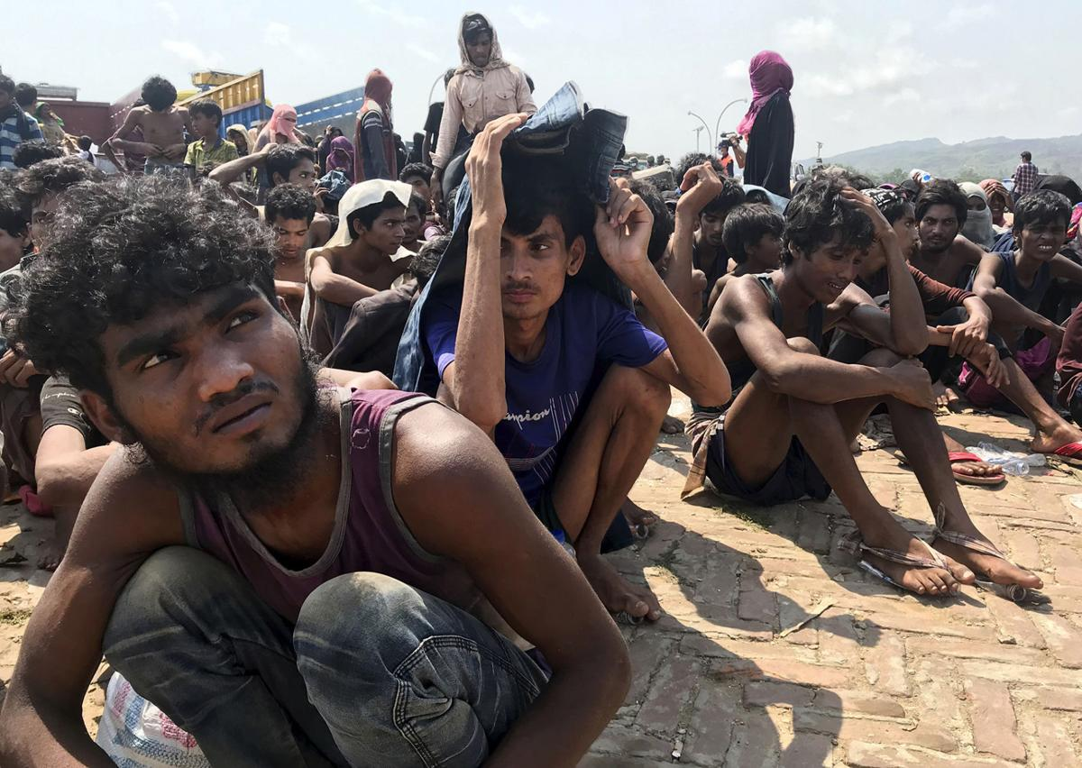
But… in the future, when the pandemic has passed, the same tools could be used to trace migrants or refugees.

Slide 26
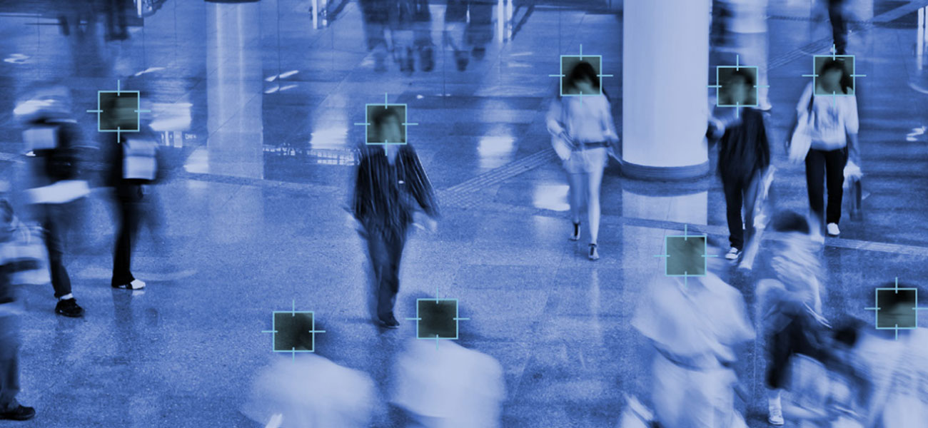
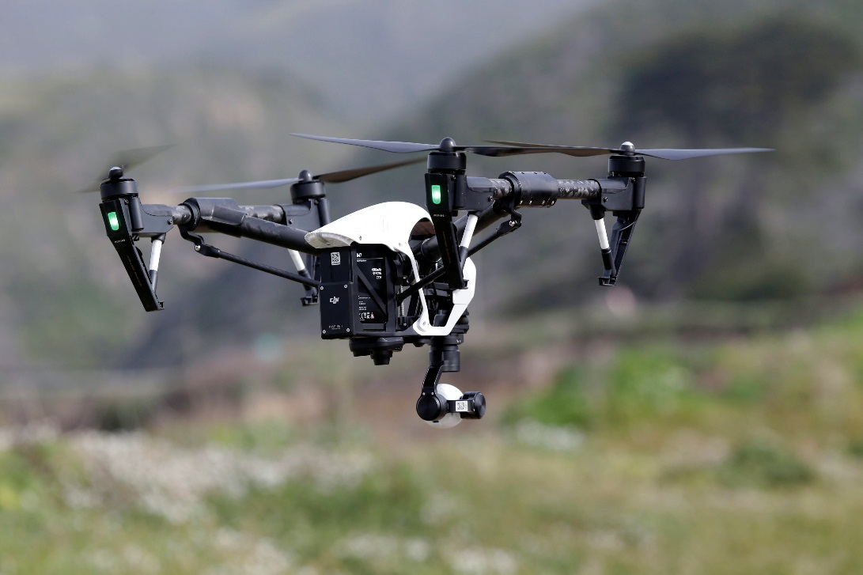
Respect for human rights must be at the heart of all these new technologies, such as the use of drones and facial recognition photography.

Slide 27
WhatsApp or similar platforms, are a great support for families which had to keep physically apart during the pandemic.

Slide 28
Downside –
the spread of misinformation regarding the origin of the virus and false claims regarding cures.

Slide 29
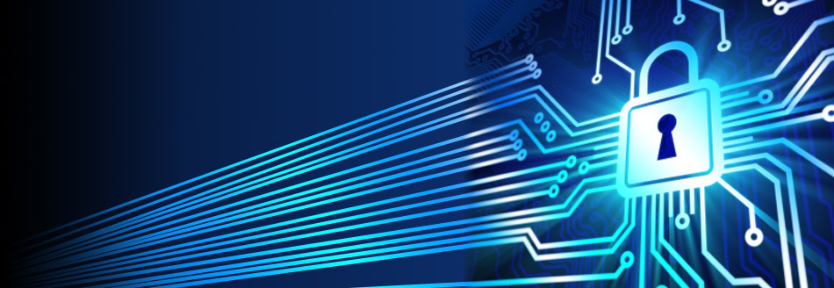
Need to understand better the risks related to communication on end-to-end encryption services.

Slide 30
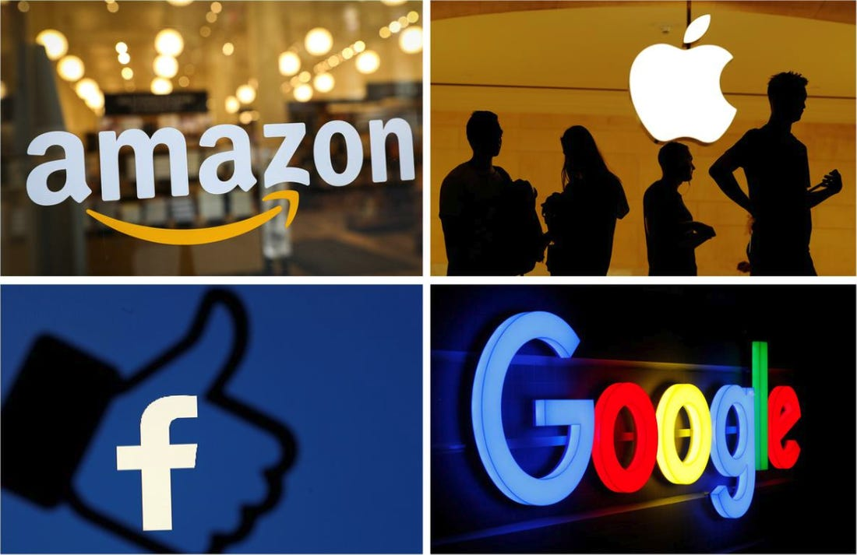
The new technologies, and the corporations which control them, such as Facebook, Amazon, Microsoft and Google can have a serious negative impact on our privacy and our freedom.

Slide 31
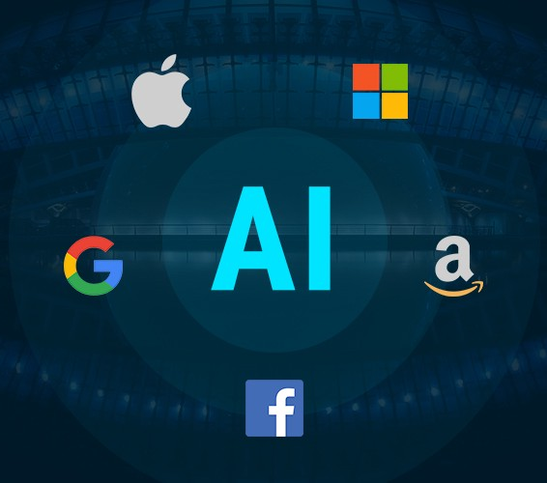
Most of Facebook’s revenue comes from advertising and it is a very lucrative business. The same is true for the tech companies. Surveillance capitalism has made these companies very rich in just twenty years.

Slide 32
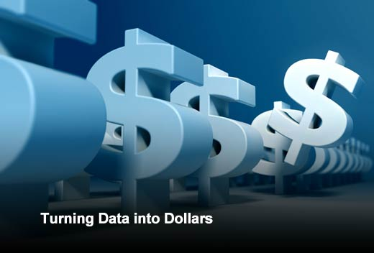
Email users who think that this service is both convenient and free, are unaware that the goal of such companies is to develop predictive data which they sell to advertisers for large amounts of money.

Slide 33
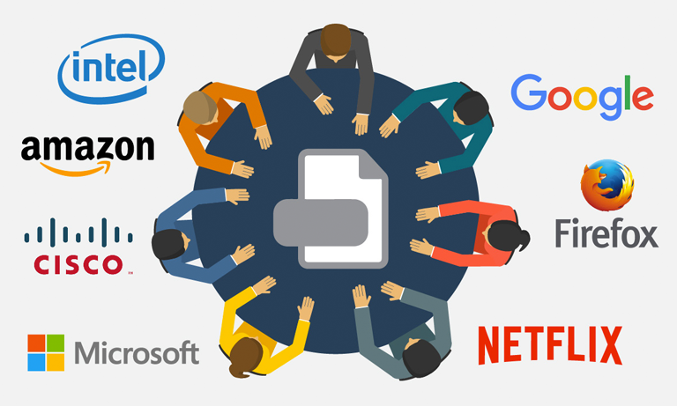
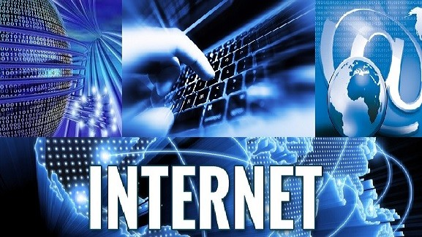
“emergence of a whole new form of capitalism based on the expropriation of personal data we freely give to vast corporations.”

Slide 34
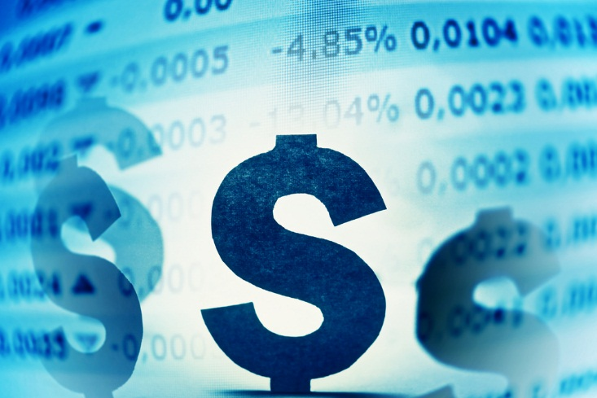
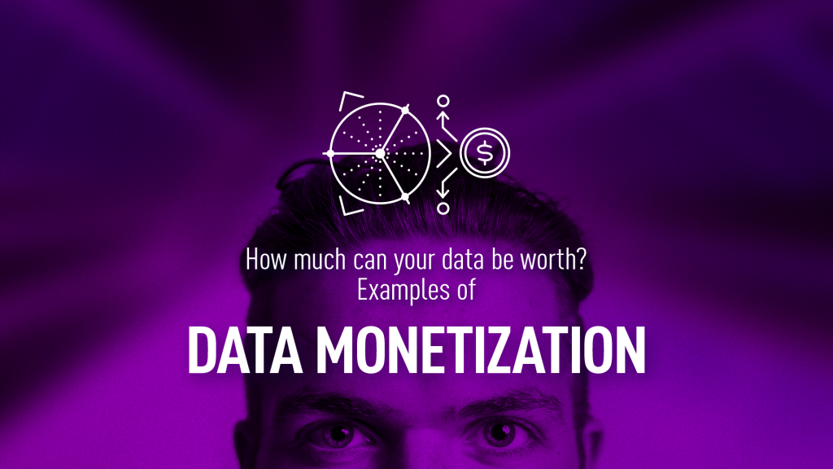
They use our data and monetise it.
And, that is the way these companies would like the situation to remain.

Slide 35
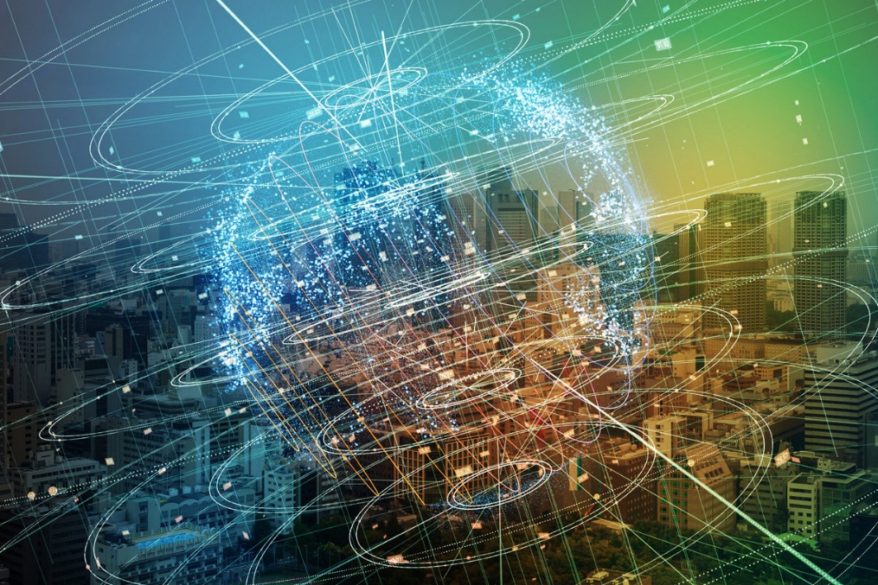
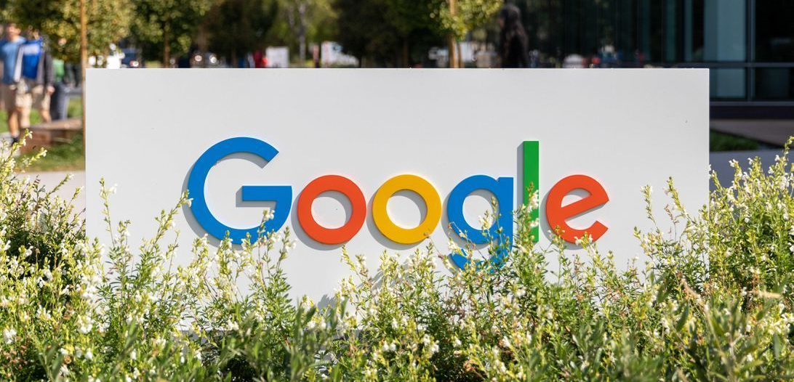
When a person uses Google to search the internet, it keeps their search history forever. This means that Google knows every search we have ever made over the years. It also tracks every video we watch on You Tube and other platforms.

Slide 36
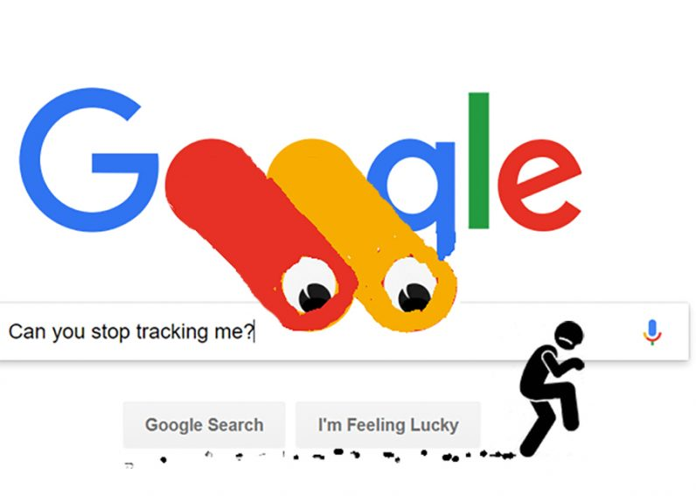
When we email, Google stores all our emails and contacts. Using Google location services, it also tracks every place we have been. The reason why Google wants to know so much about us is also to promote their advertising revenue.

Slide 37
Google - a tracking company. It records every time we see advertisements and, more importantly, whether or not we click on them.

Slide 38
May 2018:
EU General Data Protection Regulations (GDPR), to battle against the intrusive and unlawful activities of tech companies, one of the major justice issues of our time.

Slide 39
October 20th 2020:
the US Justice Department lawsuit against Google, accused of maintaining an illegal monopoly over search and search advertising, exclusionary practices harmful to competition and undermine innovation in the technology sector.

Slide 40
April 2020: Australian government decision to force big tech companies to pay other companies for media content.
For every $100 spent on online advertising, $47 goes to Google, $24 to Facebook and a pittance of $29 for everyone else.

Slide 41
Google and Facebook now control around 60% of the global advertising market. The journalists and media groups who research and report on daily events locally and globally only get a pittance of the advertising revenue.

Slide 42
As a result, newspapers reporting on these events are decreasing and media companies are closing down.

Slide 43
Competent journalism under threat gives way to the world of fake news and conspiracy theories.
Legislation is needed to protect traditional media.

Slide 44
Ethics and AI

Slide 45
The Catholic Church is very interested in software ethics and the various elements of our lives that software touches.

Slide 46
February 28th and 29th 2020: Vatican
conference on the ethical use of AI technology

Slide 47
‘algor-ethics’, the ethical use of artificial intelligence according to the principles of transparency, inclusion, responsibility, impartiality, reliability, security and privacy.

Slide 48
Pope Francis: “the aim of the ethical development of algorithms is to ensure a review of the “processes by which we integrate relationships between human beings and today’s technology.”

Slide 50
Pope Francis is very critical of how the digital culture is being used to stir up campaigns of hatred and destruction. (Fratelli Tutti, No 43).

Slide 51
Pope’s focus on the constant and febrile bonding that encourages hostility, insults and abuse of others without the restraints which normally would occur when people are in each other’s presence.

Slide 52
This type of “social aggression has found unparalleled room for expansion through computers and mobile devises.”
(Fratelli Tutti, No. 44)

Slide 53
Governments, parliaments, international bodies have an important role to play to stop criminal groups or rogue states using cyber technology and machine learning for destructive purposes.

Slide 54
Tech companies regulate themselves. But having companies monitor their own behavior is very unsatisfactory as we learned about how banks operated during the financial crash of 2008.

Slide 55
Terms

Slide 56
artificial intelligence

Slide 57
algorithm
a set of instructions to solve a problem or perform a computation.

Slide 58
Named after the Persian scholar, Mohammed ibn-Musa al-Khwarizmi (780 – 850 AD), produced works on mathematics and astronomy, also known as the father of algebra.
In Latin, he was known as Algorithm.

Slide 59
Cyber-security
the protection of computers from theft or damage to their hardware, software or electronic data.

Slide 60
Cloud Robotics
storing and accessing data and programmes over the internet, instead of using the computer’s hard drive.

Slide 61
Big Data
extremely large data sets analysed by computers to reveal patterns, trends and associations, especially relating to human behaviour or interactions.

Slide 62
Moore’s Law
a computing term from the 1970s -- the processing power of computers doubles every two or three years, and this is why computers are becoming more powerful.

Slide 63
Because the corona virus had caused people to spend more time online, the software giant Microsoft had seen “two years worth of digital transformations (accomplished) in two months.”

Slide 64
In the post-Covid-19 era, we are not going back to the past, in fact, this is the new normal

Slide 65
AI, robots and drones have, and will continue to benefit our society in many ways.

Slide 66
Downside --
it may be impossible for 40-50% of people worldwide to find paid employment in certain fields or industries.

Slide 67
Chapter 2
Focus on Artificial Intelligence (AI), the rapid development of algorithms, institutions, such as the Data Protection Commission, to help us to cope with the broad reach of surveillance capitalism.

Slide 68
Chapter 3
3D printing transforming manufacturing, the building industry and medical technologies; its major implications for developing countries’ economies since developed countries will manufacture their goods locally

Slide 69
Chapter 4
development of robots and drones used in the retail trade, in education, in the building industry and in mining will have a huge negative impact on jobs in the future.

Slide 70
Chapter 5
focus on the use of robots and drones, especially in agriculture. Running a smart farm in the future will involve getting more value out of agriculture through information technology, mobile phones, apps and the internet in general.

Slide 71
As these technologies begin to be used on an increasing number of farms, they will have an adverse impact on migrant workers.

Slide 72
Chapter 6
how adopting these new technologies will affect people who work in nursing homes, caring for sick and the elderly people and, also, those who work with young people.

Slide 73
Chapter 7
the economic sector, how new technologies will impact on the retail trade, banking, investment, insurance, accountancy; haemorrhaging of jobs as robot stores, robot hotels, investment algorithms and robo-accountants take jobs and exclude people.

Slide 74
Chapter 8
focus on the impact autonomous cars and trucks will have on society and the economy in the future.

Slide 75
Approximately 3.5 million professional truck drivers in the United States serviced by a large back-up of hotels, motels and shops. This sector of the economy will see major changes in the next twenty years and fewer people will be employed.

Slide 76
Chapter 9
the development and impact of military robots and drones on warfare worldwide.

Slide 77
Military robots and drones can be used, not just by governments, but, also by terrorists, as drones are relatively inexpensive to manufacture.

Slide 78
Military conflicts in the future will not be fought as they were in the past. The chapter deals with the ethics of killer drones and argues that the autonomous use of weapons is immoral.

Slide 79
Chapter 10
the case for a universal basic income since, in the future, many people will not have a paid job and will not have enough money to meet their basic needs.

Slide 80
Unless this problem is addressed we could be creating a very unequal society, with a small group of very wealthy people and the rest of the population living from hand to mouth.

Slide 81
Chapter 11
the new technologies in the light of the key points of Catholic Social Teaching, particularly the meaningfulness of work and its importance for human beings.

Slide 82
Robots, Ethics
and the Future of Jobs
Sean McDonagh, SSC
Images sourced from the Internet December 2020

