Slide 1
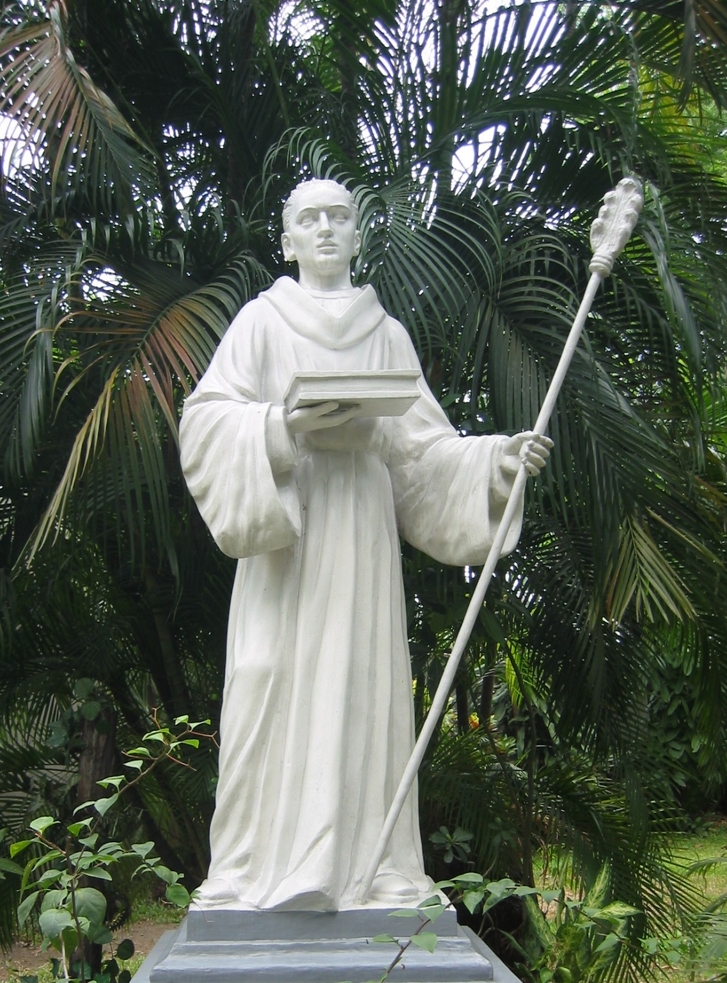
Columban’s understanding of God --
a Christian response to
climate change and
the destruction of biodiversity
Sean McDonagh, SSC

Slide 2
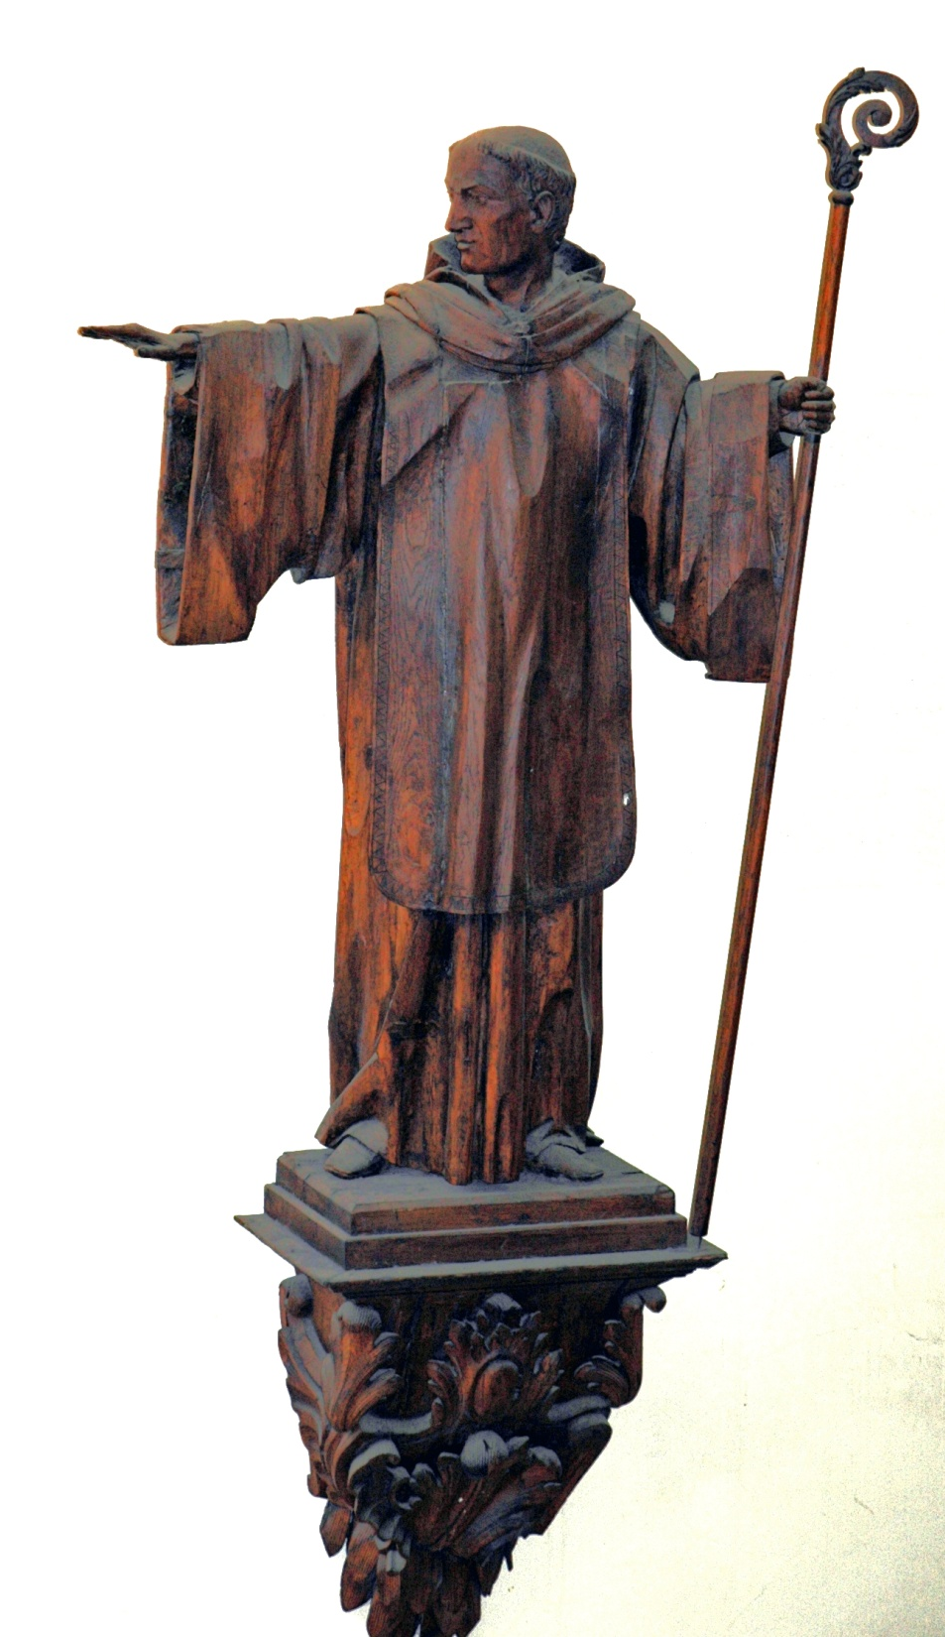
In his life as a
Peregrinatio Pro Christo - wanderer for Christ - Columban has much to teach us about his sensitivity to God’s creation which is much needed in our world and Church today.

Slide 3
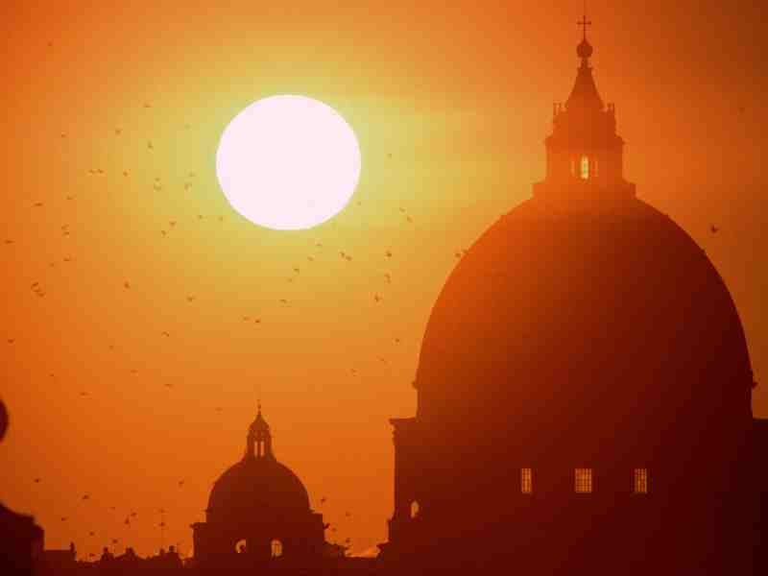
Often this has not been the case
Down through the ages, many Christians did not believe in any kinship or compassion between human beings and other creatures.

Slide 4
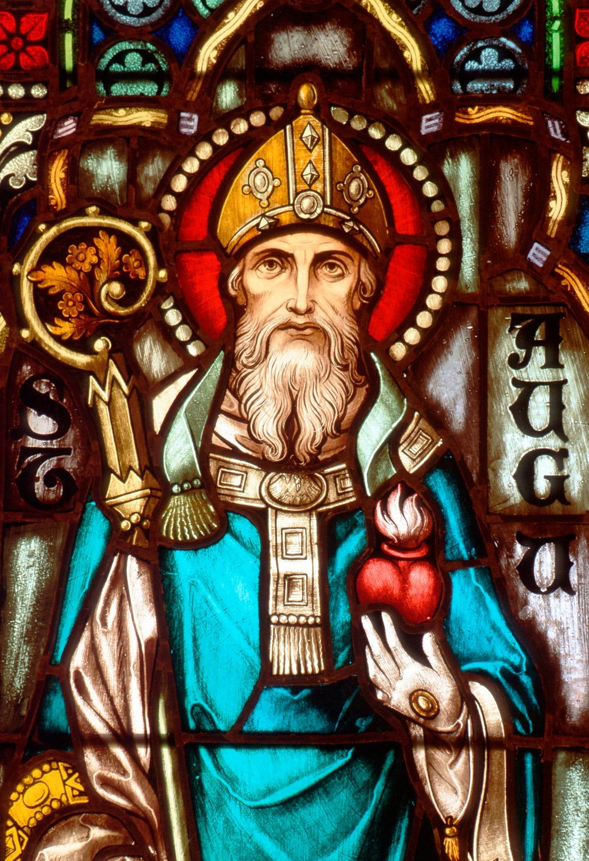
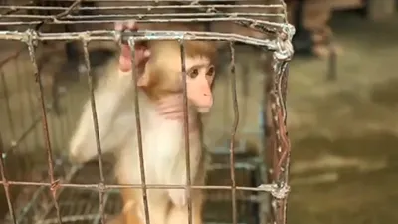
St. Augustine: “Reason has not been given to animals and so, by the most just ordinances of the Creator, both their lives and their deaths is subject to our use.”

Slide 5
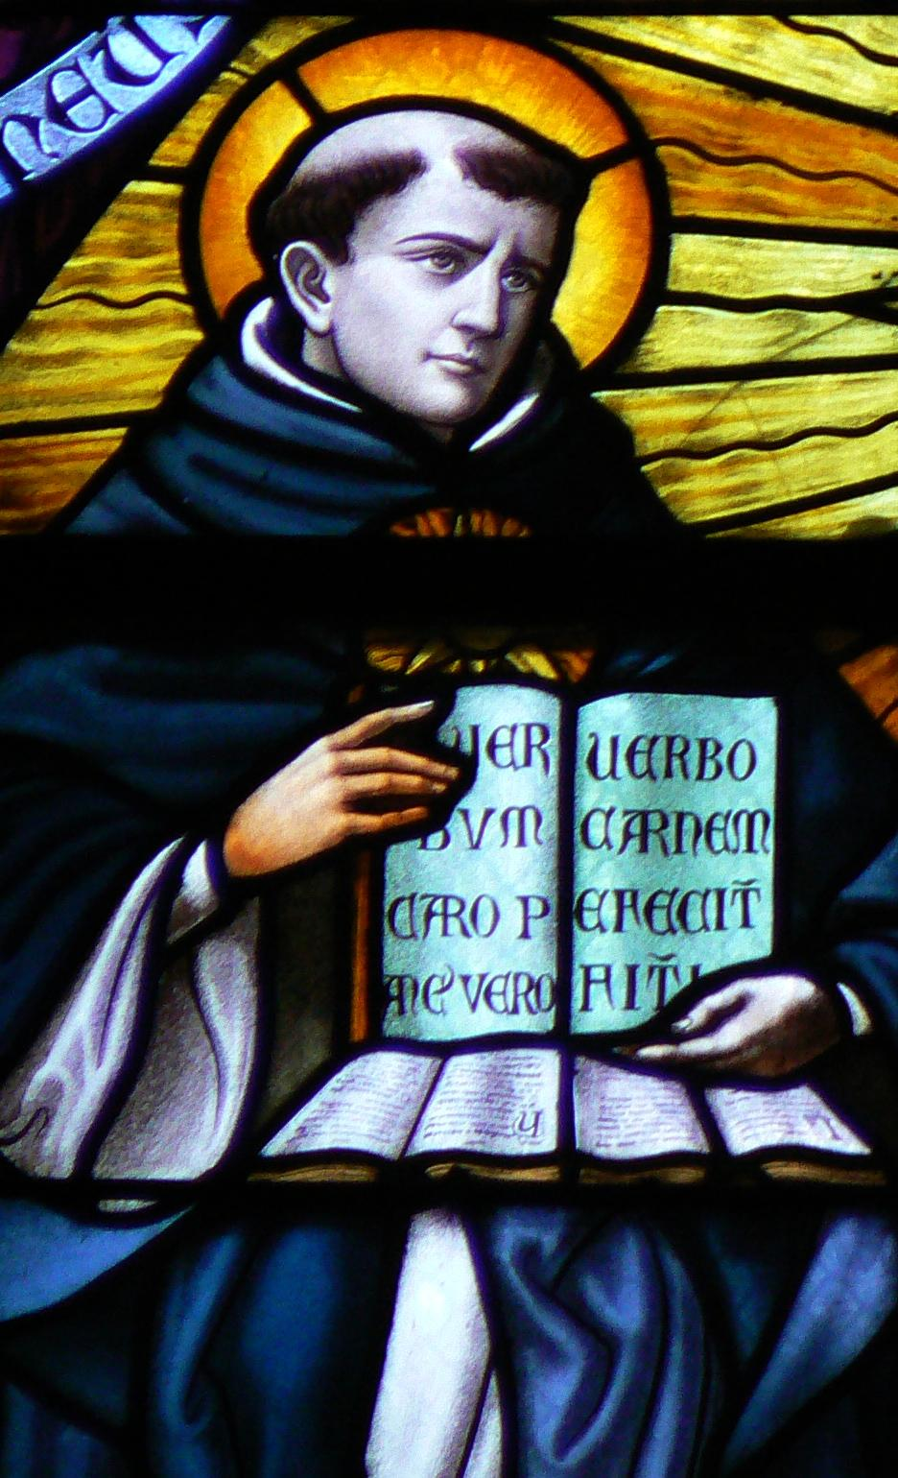
Thomas Aquinas believed animals had no ethical value:
“We have no duties of charity, nor duties of any kind to the lower animals, as neither we have for sticks and stones…”

Slide 6
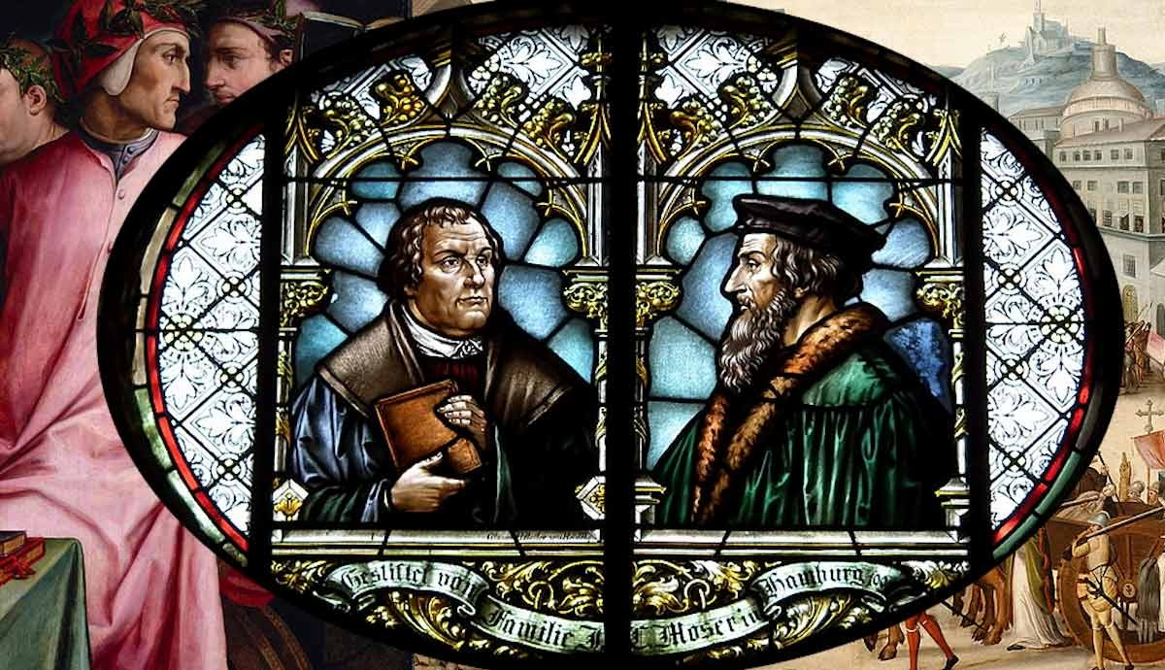
“ONLY CATHOLICS?”- This vision of creation that allows humans to use creatures and the natural world in any way they wish was also held by both
Martin Luther
John Calvin.

Slide 7

Luther’s contrast between the Kingdom of Heaven which operated under God’s grace and the Kingdom of the World which operated under God’s wrath intensified the split between the ‘material’ and ‘spiritual’ dimension of the Earth which was already deeply embedded in Western culture and religion.

Slide 8
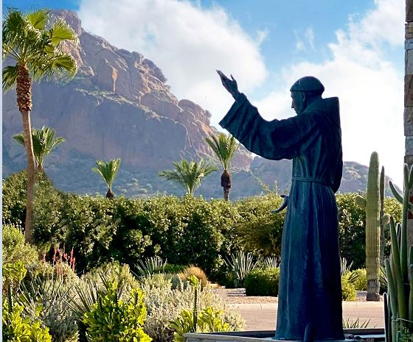
ONE EXCEPTION: St. Francis of Assisi - Seldom do humans show the kind of empathy towards nature that was so typical of him.

Slide 9
Today most Christians believe that
Christianly focuses on redemption of humans- saving them “from the world”.
It often fails to grasp the fact that humans are damaging the world through climate change, the destruction of species and the pollution of water.

Slide 10
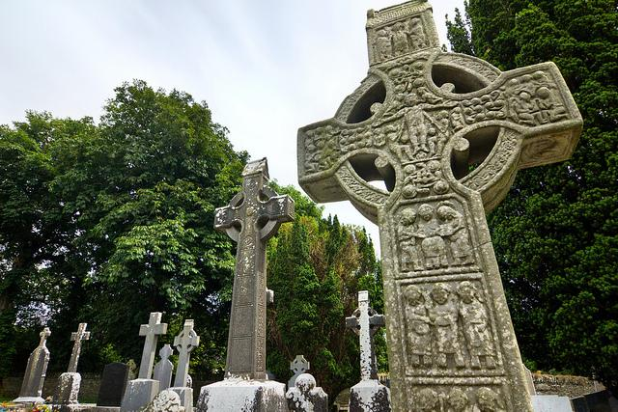
The Vision of God in early Irish Christianity
Anyone who visits the sites of Columban monasteries is struck by the beauty of their natural setting.

Slide 11
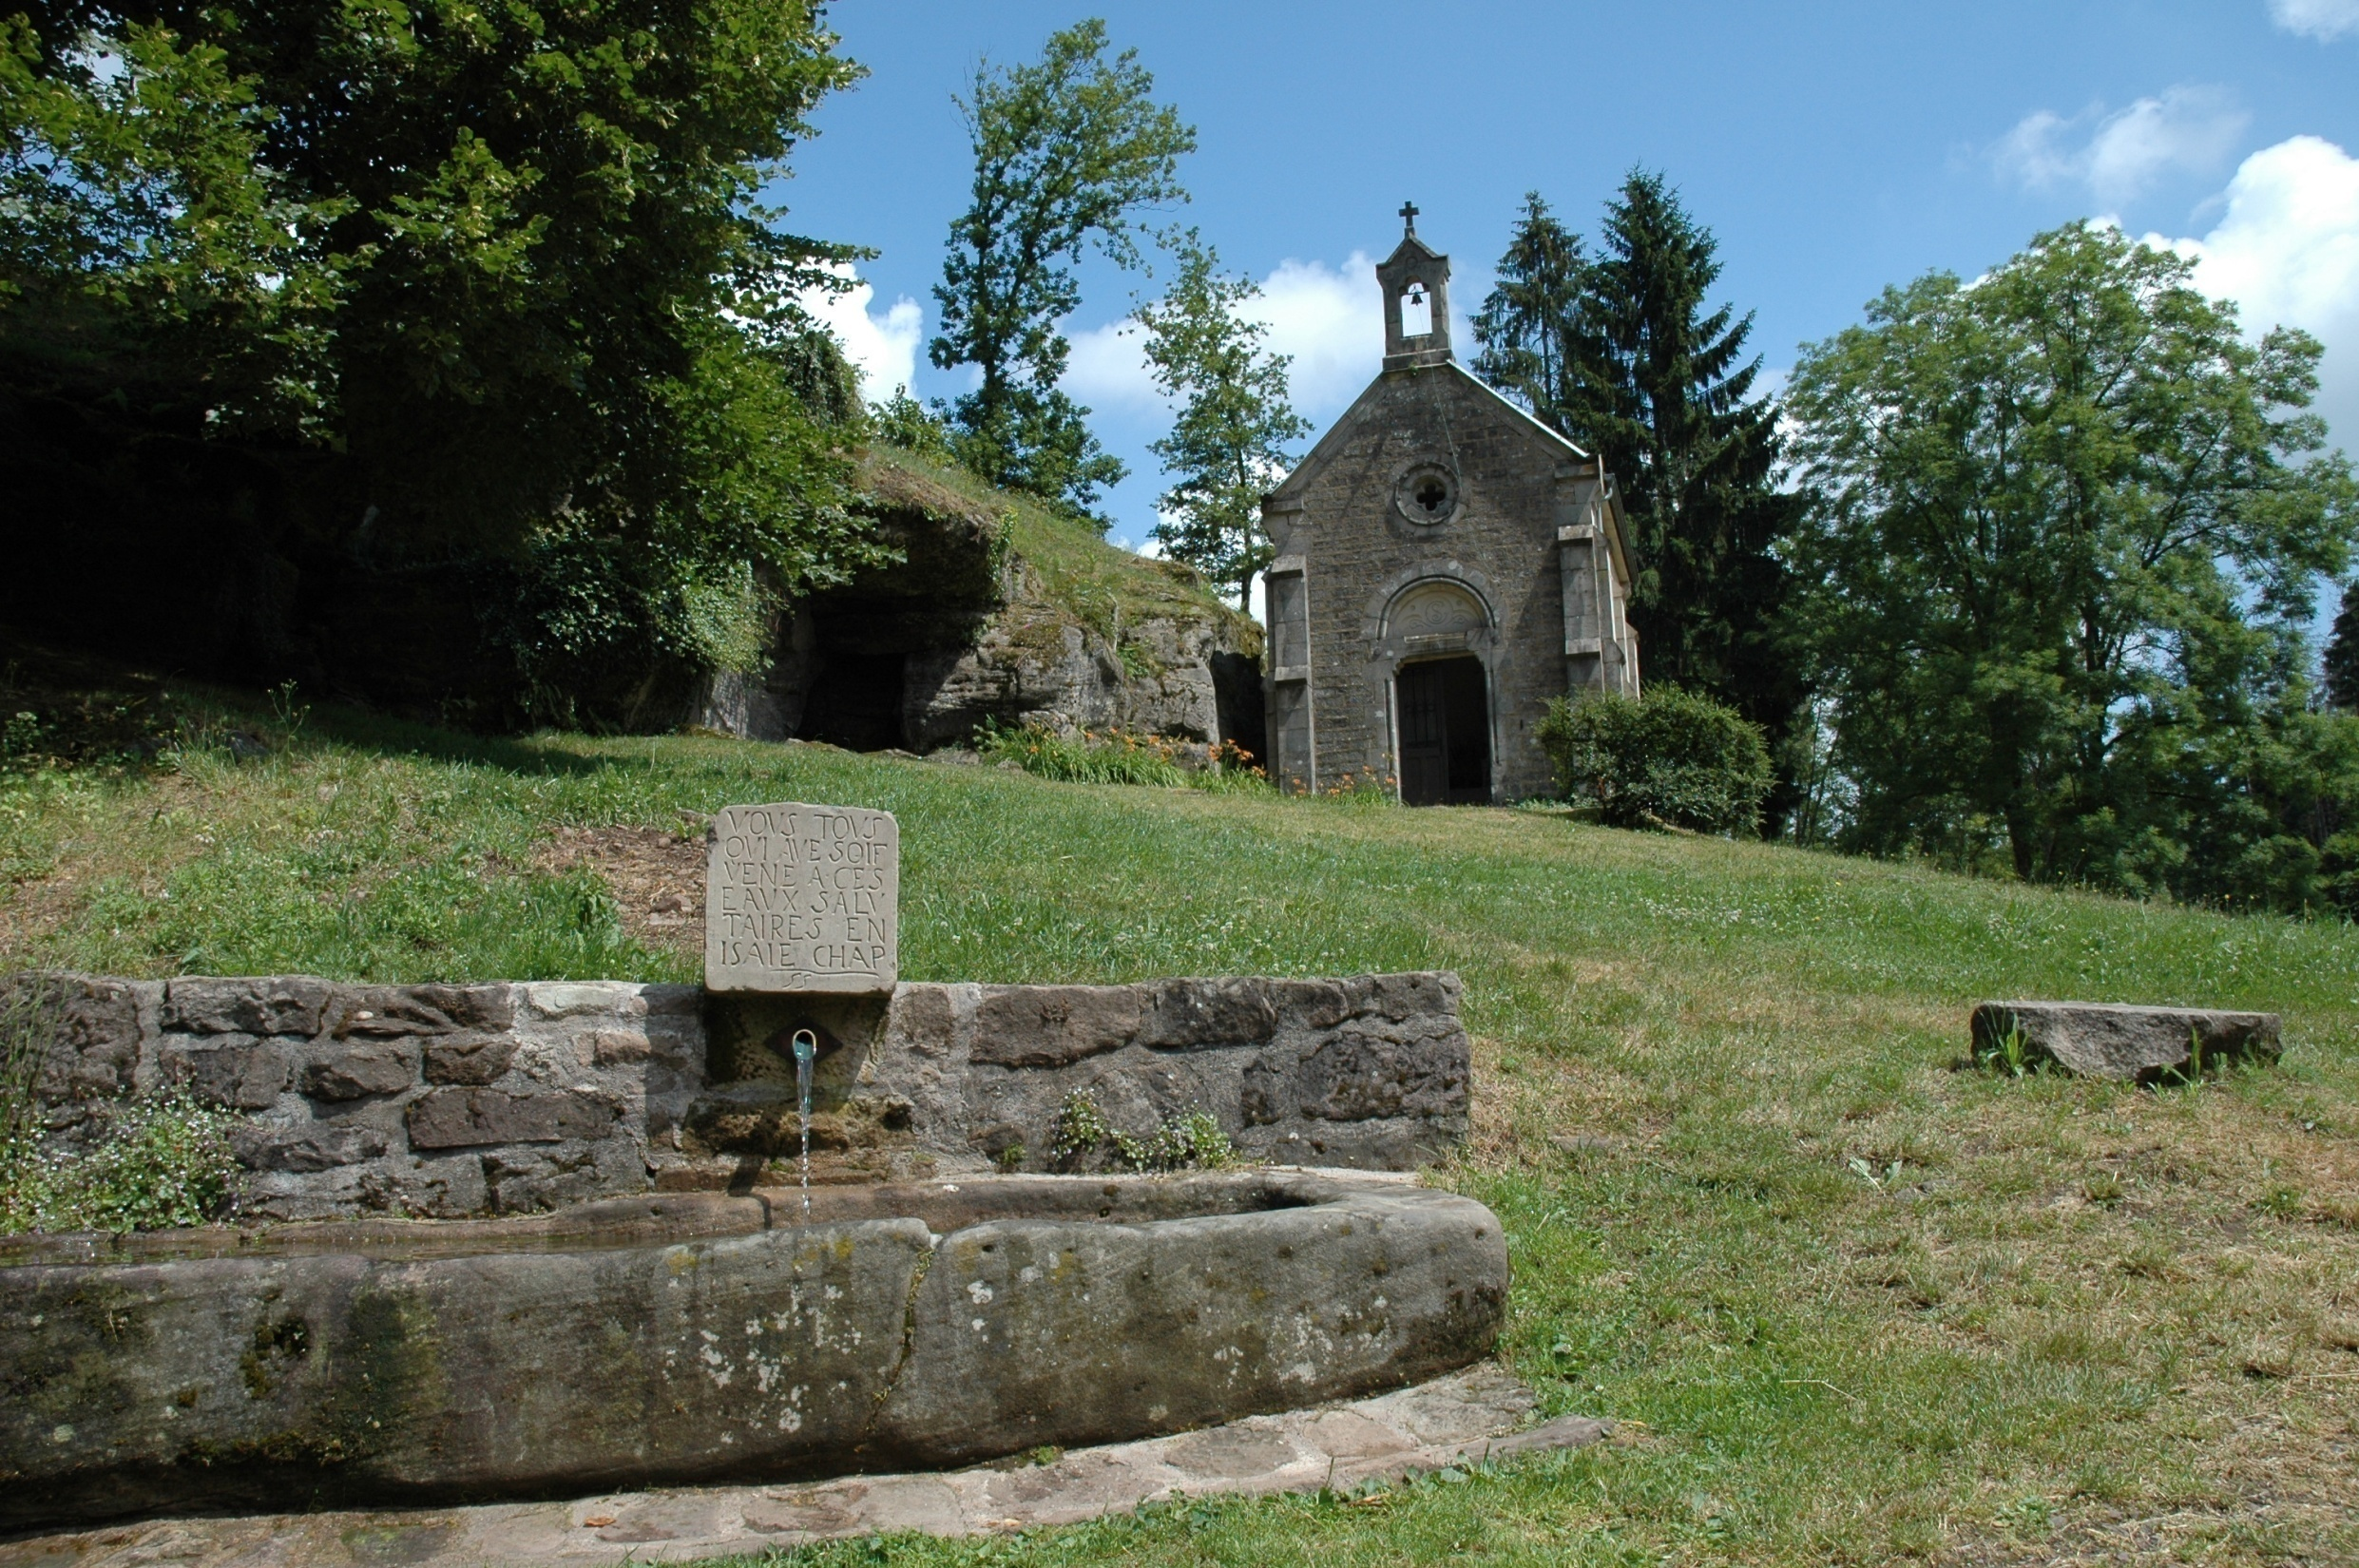
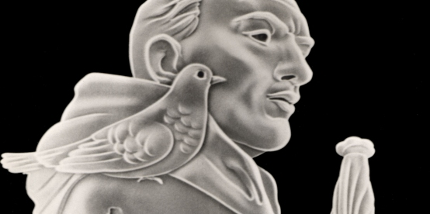
Finding God in creation came naturally to Columban. Many legends grew up in Luxeuil
.
Stories claim that as he walked in the woods, it was common for birds to land on his shoulders to be caressed, or for squirrels to run down from the trees and nestle in the folds of his cowl.

Slide 12
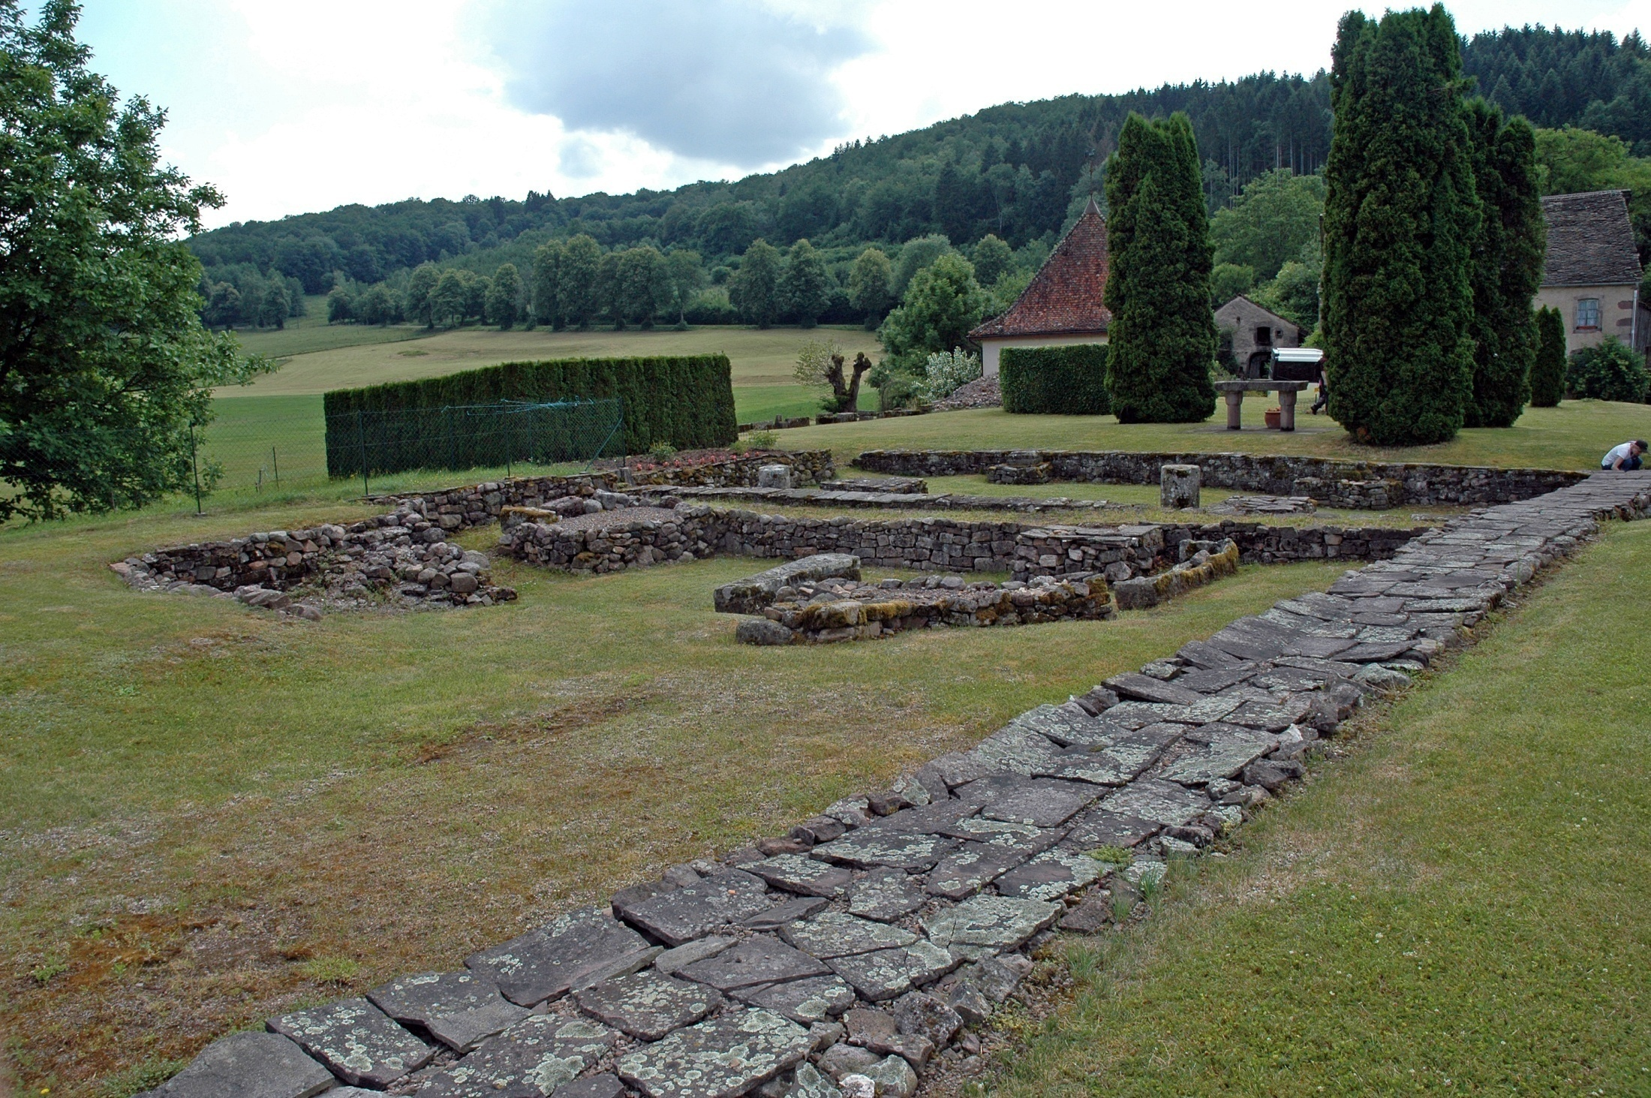
Columban- mystic, monk, and missionary - was very attuned to the beauty and wonder of the natural world.
In Sermon 1, he wrote in excellent Latin –
Intellige, si vis scire Creatorem, creaturam
“If you wish to know the Creator, understand creation.”

Slide 13
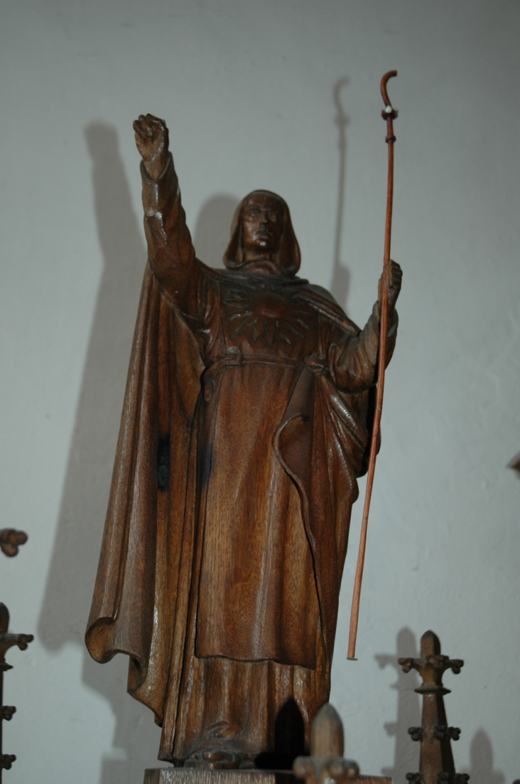
Columban is telling us today that our Christianity
must move from an exclusive concern for human salvation
and include real concern for the Earth and God’s creation.

Slide 14
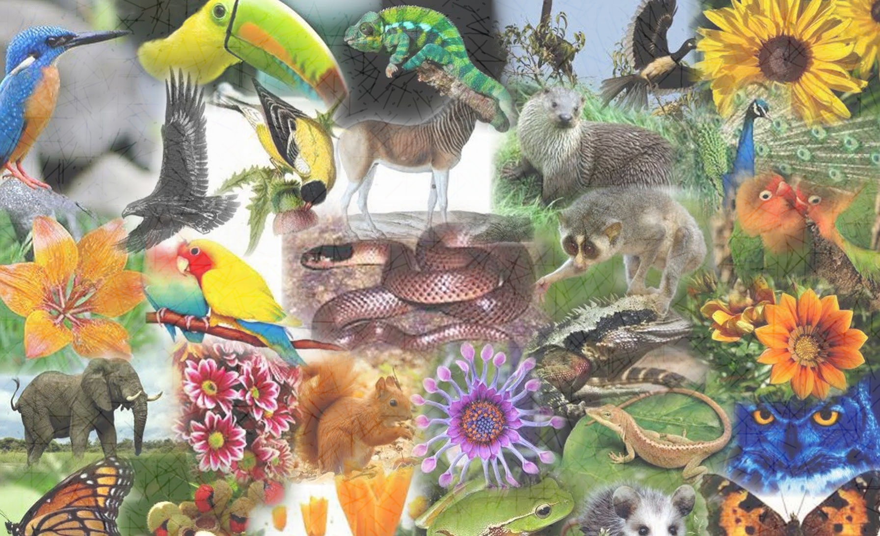
Ethically, every being has rights that should be recognised and cherished.
They have the right to be
and the right to fulfil their role in the renewable processes of the Earth community.

Slide 15
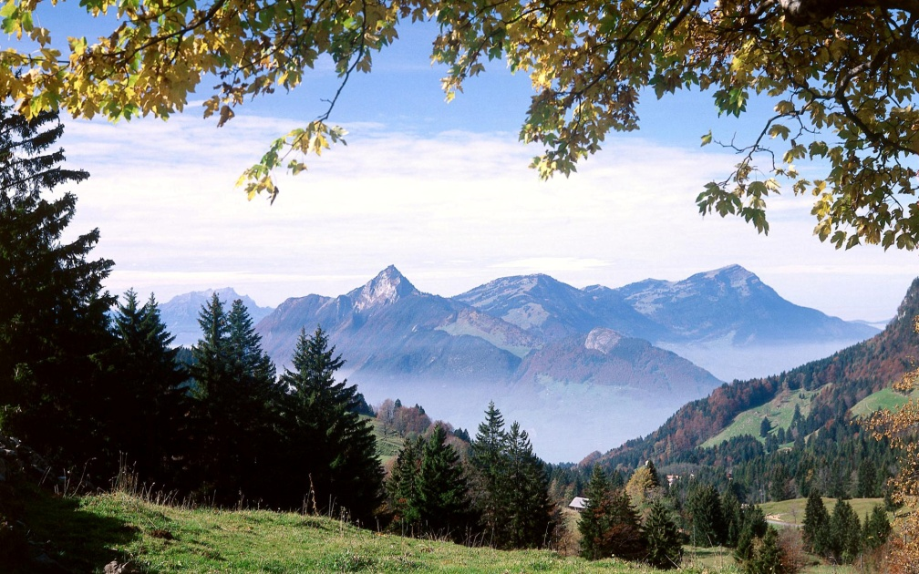
Trees have tree rights;
insects have insect rights
and even rivers have river rights.
And we humans must recognise them !!.

Slide 16
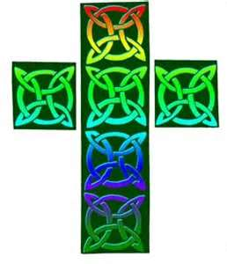
Our Christian faith must face the two issues which are central to the Earth.
Climate Change and
the Massive Destruction of
Biodiversity.

Slide 17
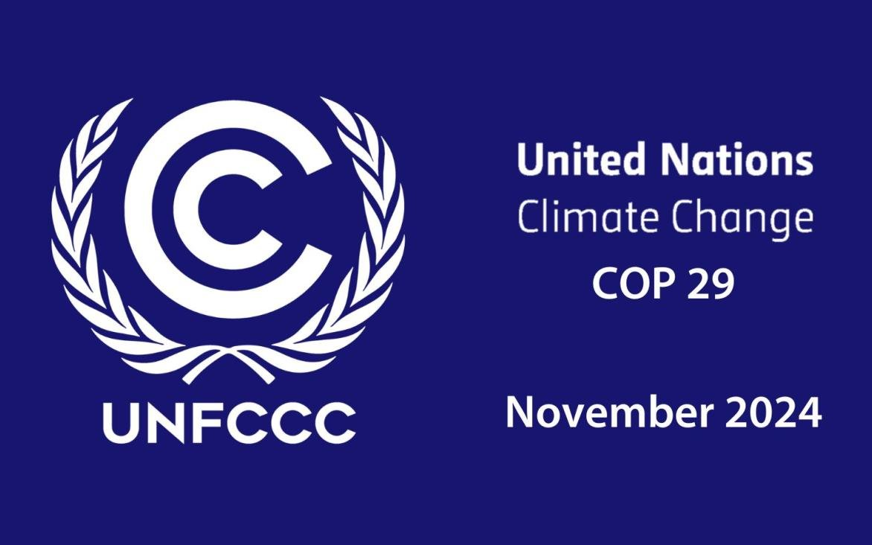
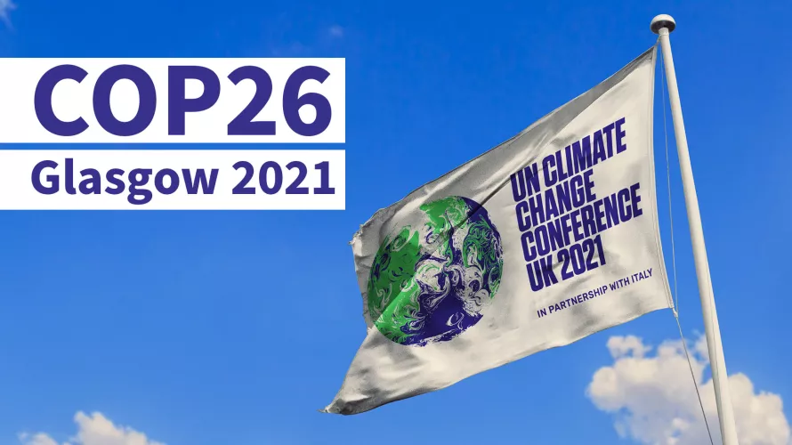
Climate change receives a lot of publicity in the run-up to the UN ‘COP’s (The Conference of the Parties) each October and November.
Many people were disappointed with the outcome of COP26 hosted in Scotland in 2021.

Slide 18
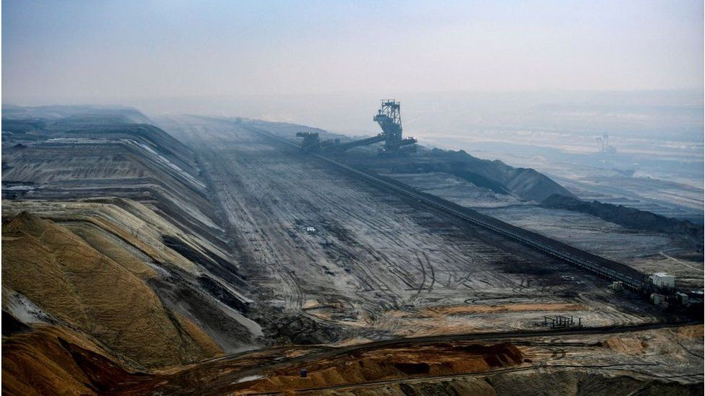
It failed “to keep the goal of 1.5℃ alive”, by failing to
accelerate the decarbonisation of the global economy,
phase out coal.
It also did not raise sufficient money among rich nations to allow poorer nations to adapt to climate change and steer their economies away from burning fossil fuels in the future.

Slide 19
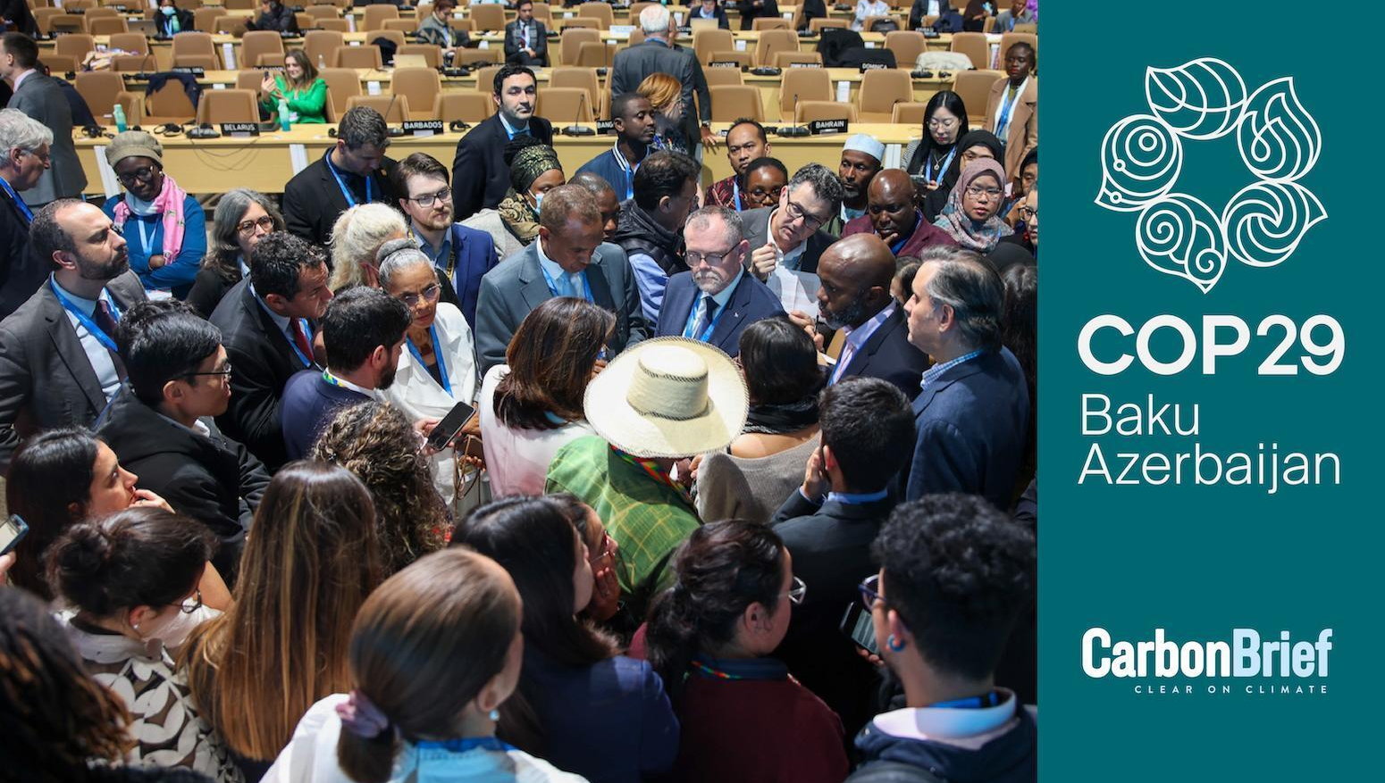
But, at least, the public did hear the arguments so that we can judge for ourselves how successful these COPs have been.

Slide 20

On his first day as President in January 2025, Donal Trump withdrew the United States from the Paris Agreement . The efforts of the Biden administration to reduce greenhouse gases will not be met. And since the US has left the Paris Agreement, other nations will do likewise.

Slide 21
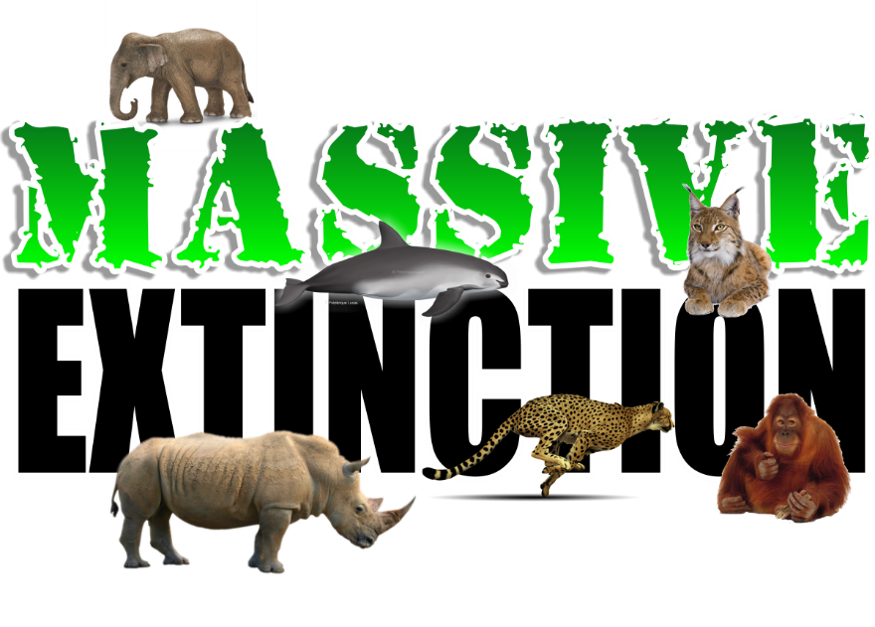
Extinction
We are living through the sixth greatest period of extinction since life began 3.8 billion years ago.

Slide 22
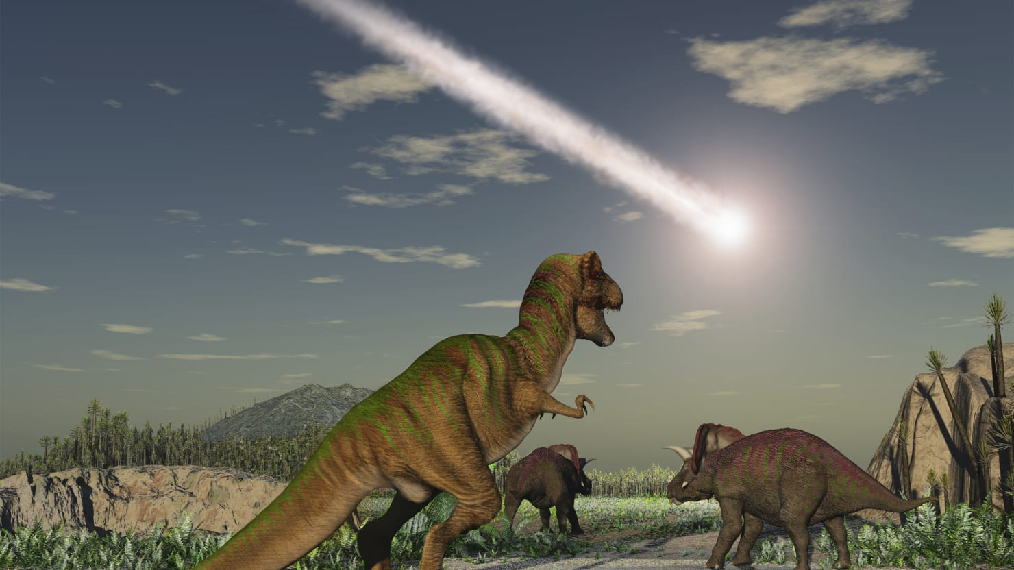
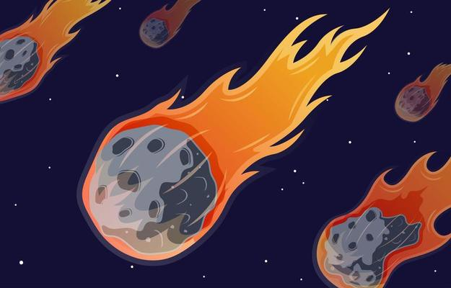
65 million years ago a meteor crashed into the Gulf of Mexico, produced high levels of volcanic activity and significant amounts of carbon dioxide which led to the extinction of many creatures, including the dinosaurs.

Slide 23
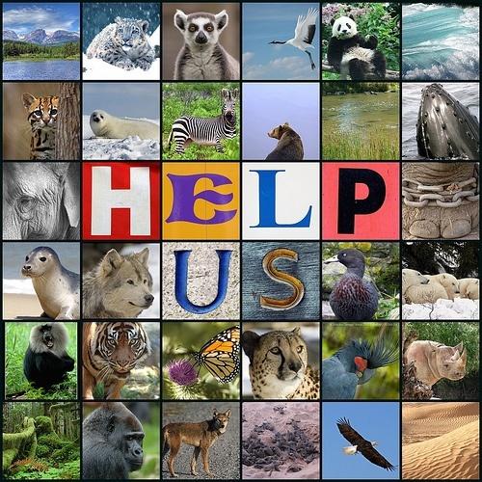

But now things are worse:
One in five mammals,
One in four plants,
One in three amphibians &
One in eight birds
are in danger of being pushed over the precipice of extinction.
[The International Union for the Conservation of Nature (IUCN), 2010]

Slide 24
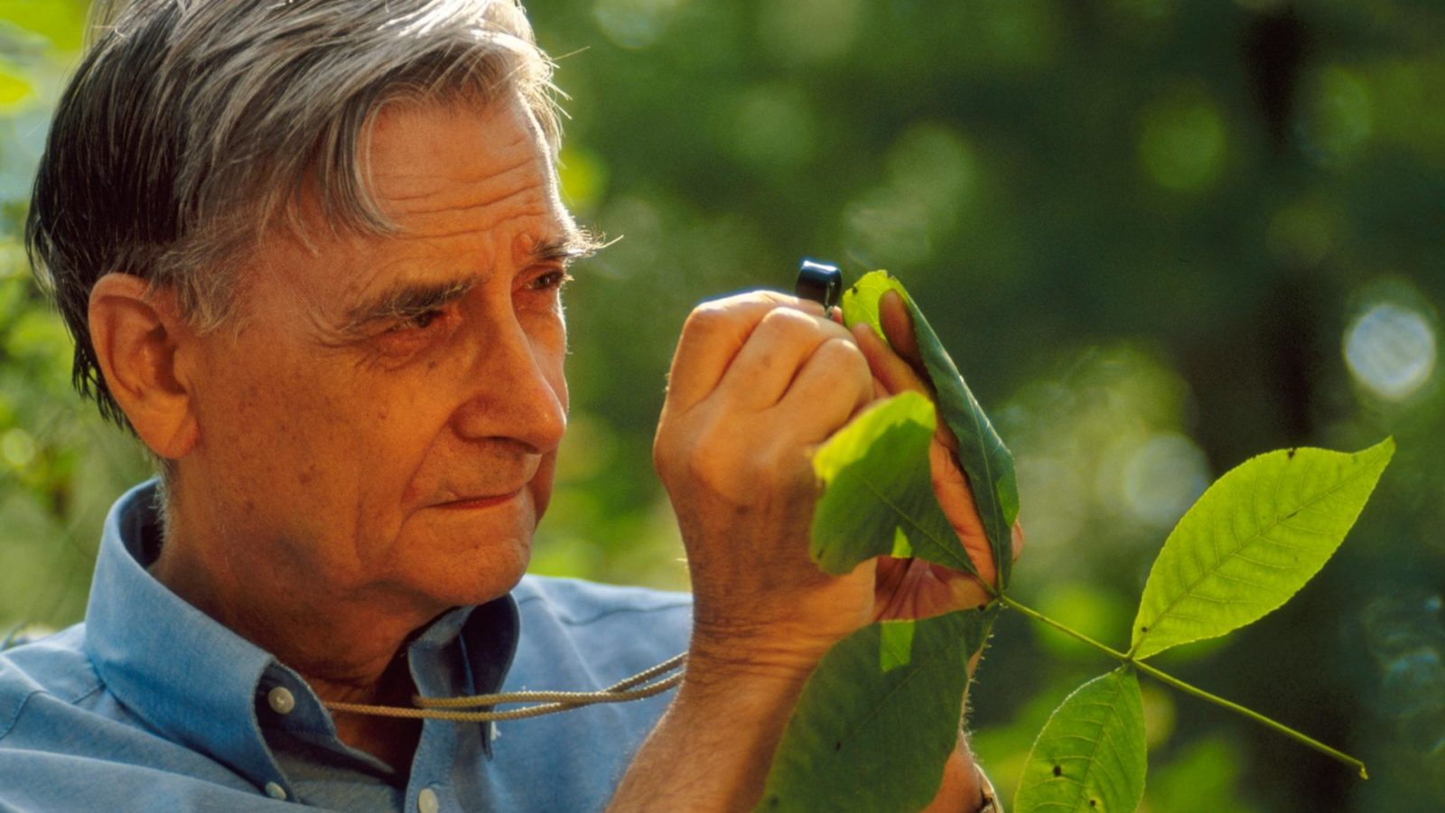
“The quenching of life’s exuberance will be more consequential to humanity than all present day warming, ozone depletion and pollution combined.”
[Harvard biologist, Edward O Wilson, 2005]

Slide 25
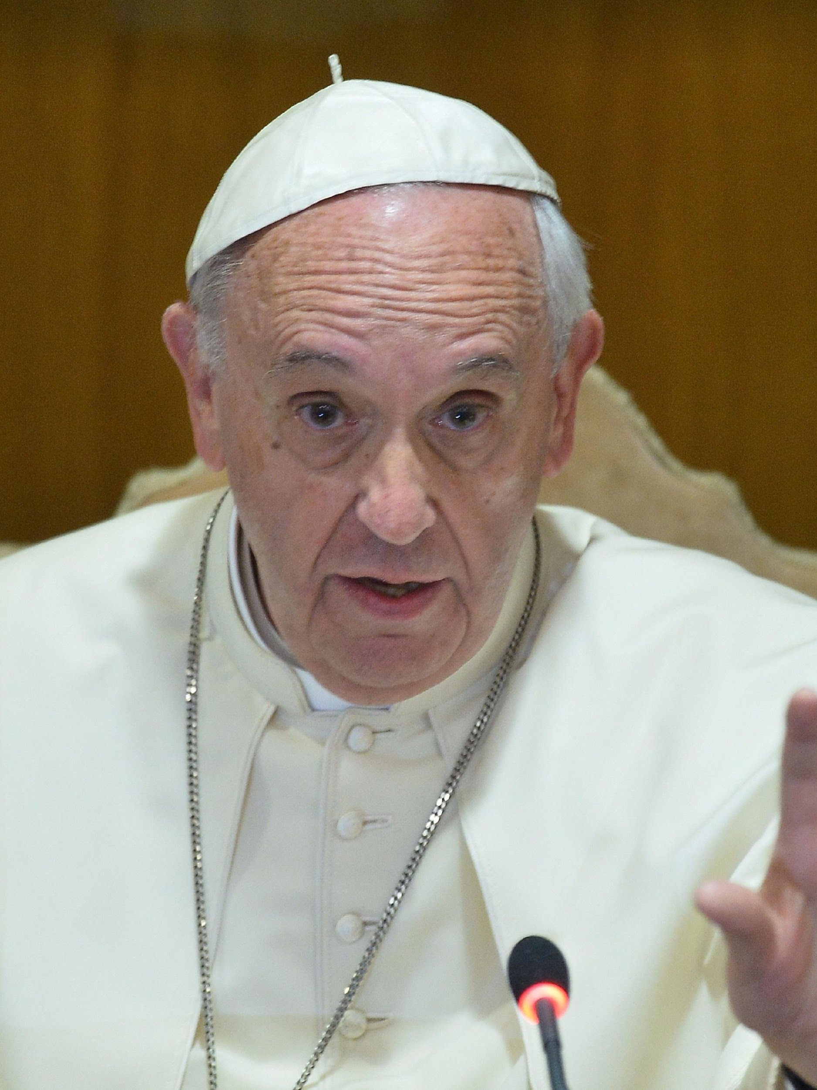
Pope Francis laments the fact that ‘the loss of forests and woodland entail the loss of species which may constitute extremely importance resources in the future, not only for food but also for curing disease and other uses. [Laudato Si’ 24]

Slide 26
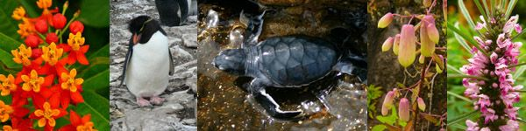
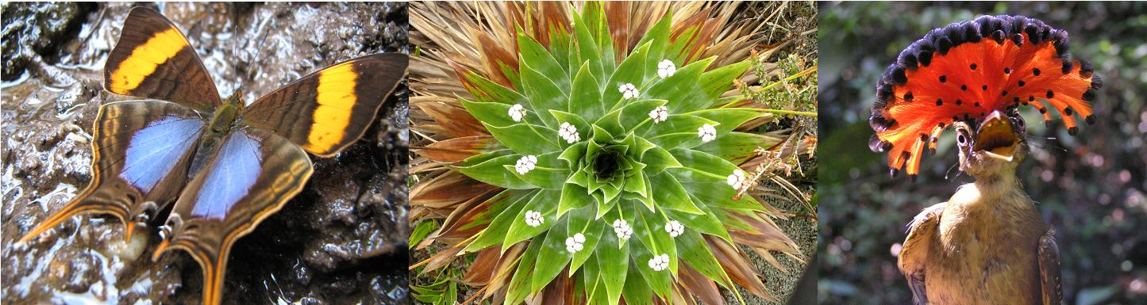
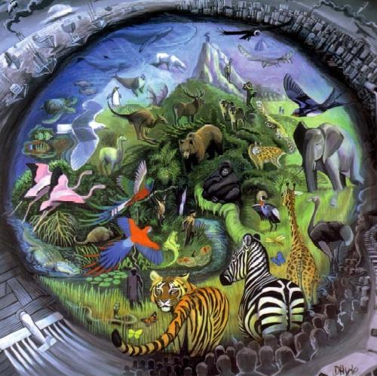
“by destroying biodiversity human beings ignore the fact that all creatures have “intrinsic value in themselves independent of their usefulness.” [Laudato Si’]
biodiversity

Slide 27
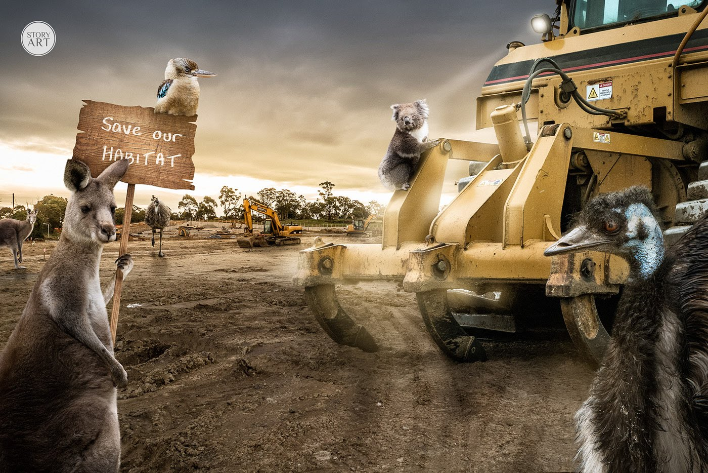
Unless we tackle biodiversity loss seriously, we could lose a million species in this century. This would be a disaster for every generation of humans and other life-forms who will live in this world, and it will impoverish the planet forever.

Slide 28
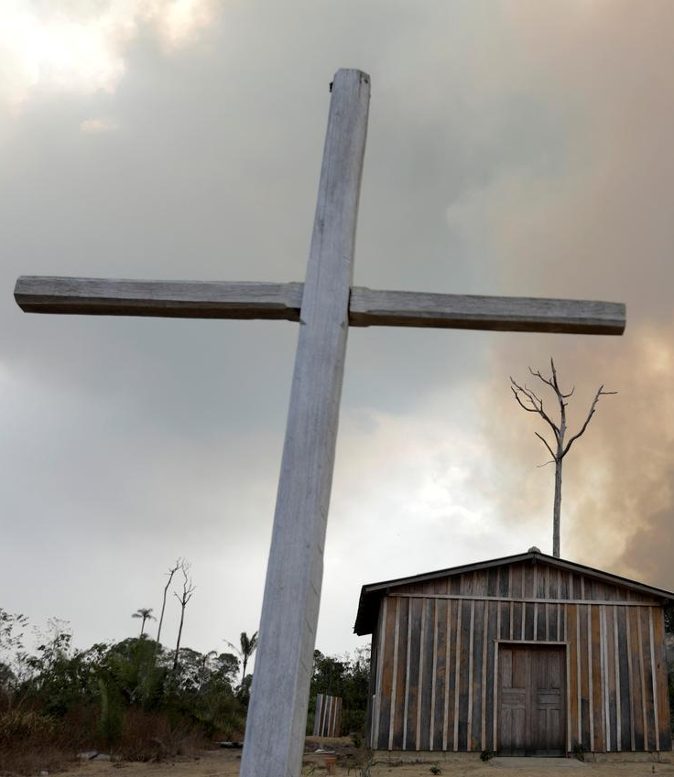
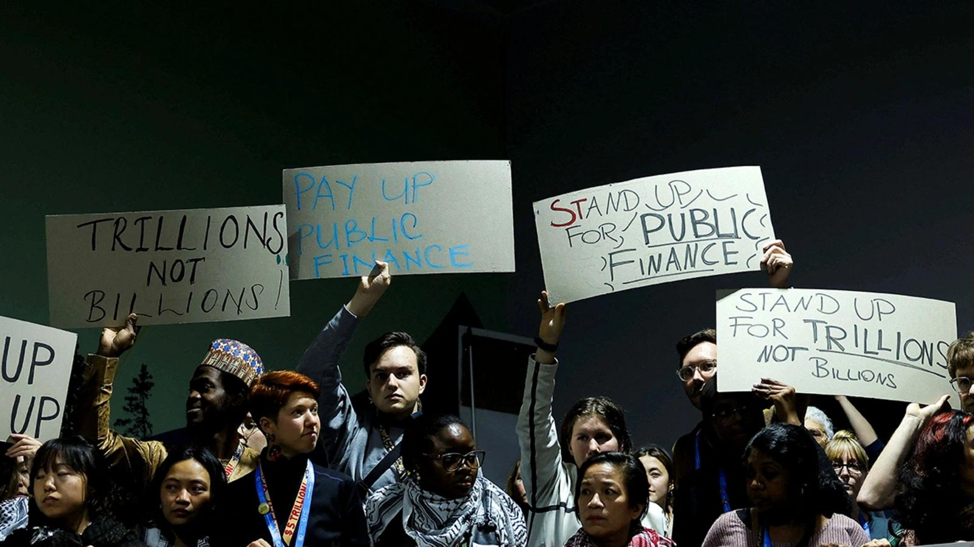
The Christian Churches, as midwives of God’s reign, must speak the truth about global environmental destruction in a much more forthright and unambiguous way.

Slide 29
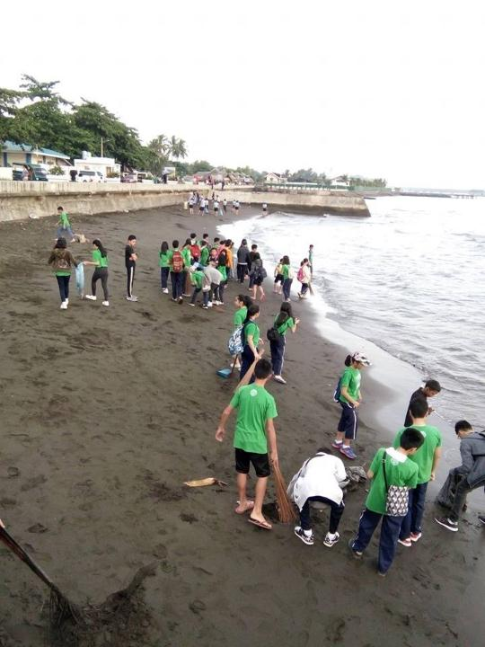
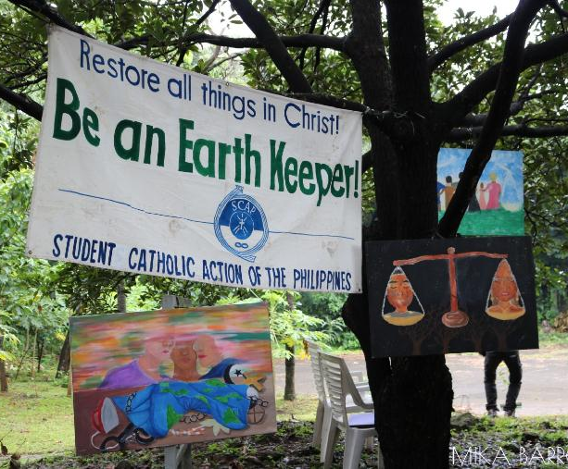
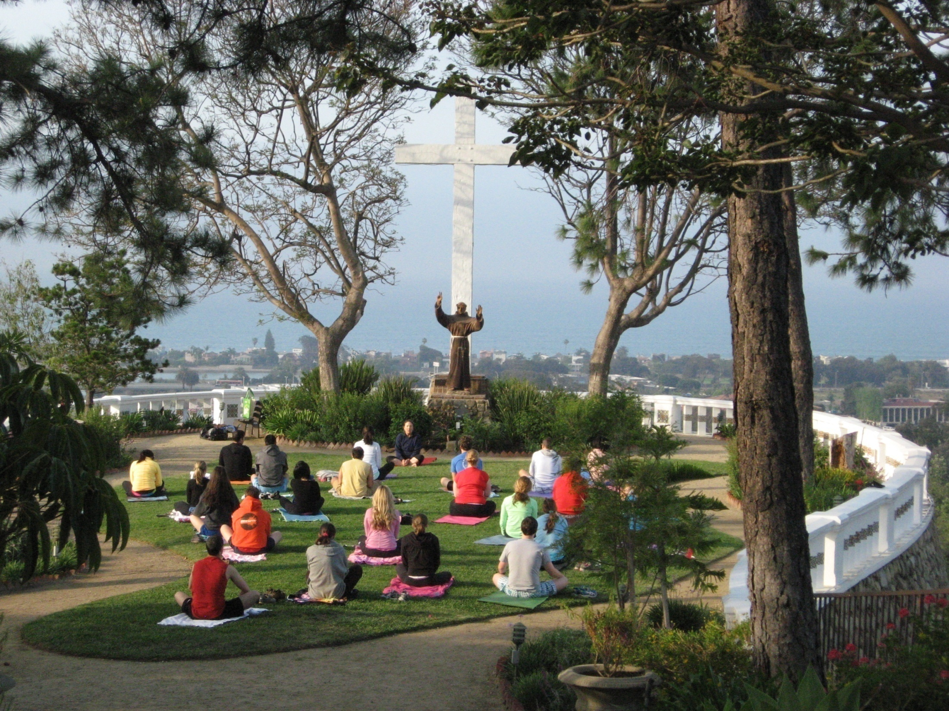
They should encourage new ways of living which are much less destructive than those we have in place in our fossil fuel-addicted world.

Slide 30
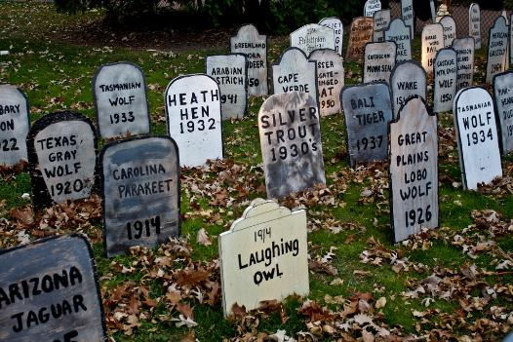
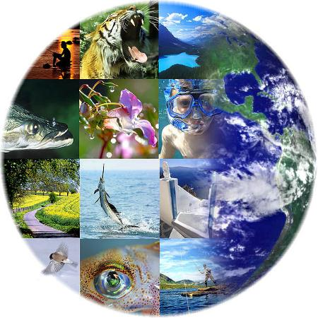
The Churches should be willing to introduce requiem liturgies in honour of those creatures that are facing extinction.

Slide 31
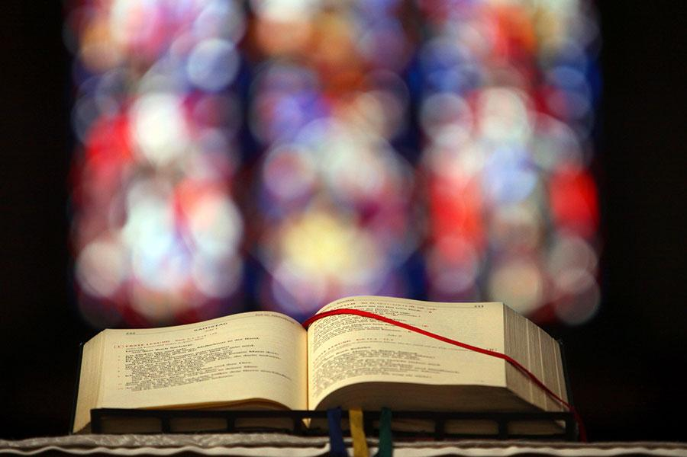
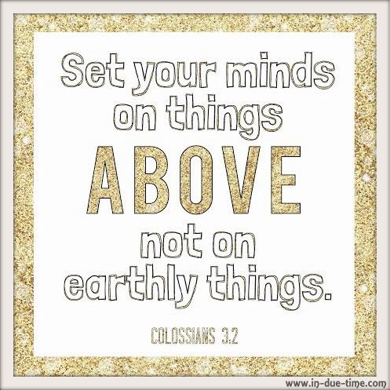
For almost four centuries the “Post-Communion” prayer in the Roman Missal prayed
Oremus. Doceas nos terrana despicere at amara celestal.
“teach us to despise the things of earth and to love the things of heaven.”

Slide 32
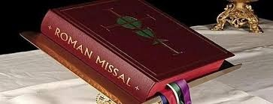
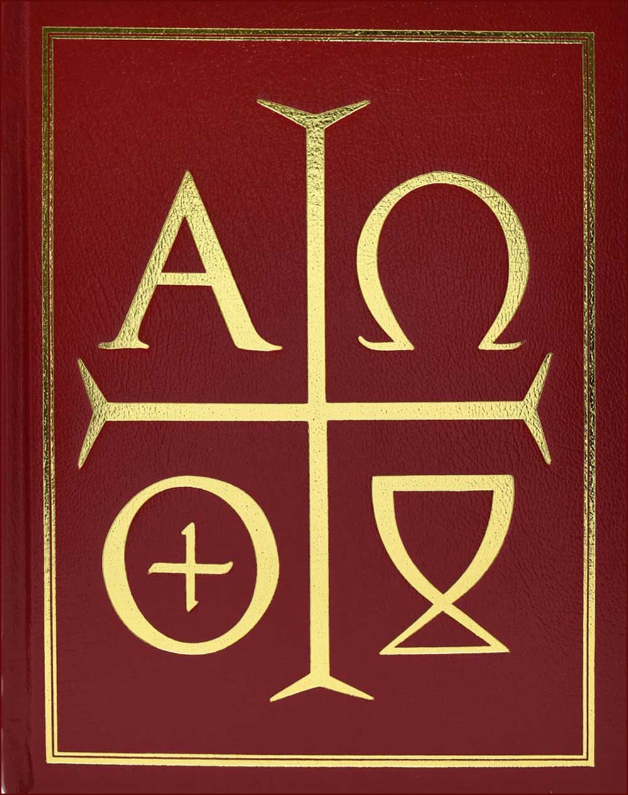
The current Post Communion prayer is almost
as bad. It reads –
Oremus, Domine, docens nos terrena sapieter perpendere at caelestibus inhaerere.
“Let us pray, teach us to use wisely the things of earth and hold firm to the things of heaven.”

Slide 33
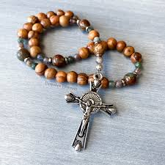
The Rosary is one of the most important prayers for Catholics for the past millennium. Once again sensitivity to God’s creatures is missing.
In the Salve Regina “To thee do we cry poor banished children of Eve. To thee do we send up our sighs mourning and weeping in this valley of tears.
Our world is not a valley of tears. The more we know about it the more we appreciate its beauty.

Slide 34
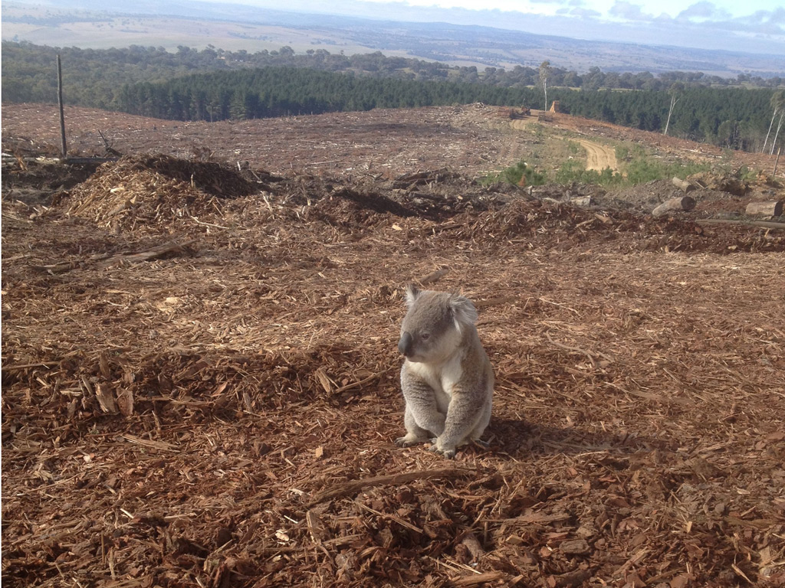
Focusing on creation will have us standing with the victims, including the suffering Earth.
We challenge corporations and others who are currently destroying the world.

Slide 35
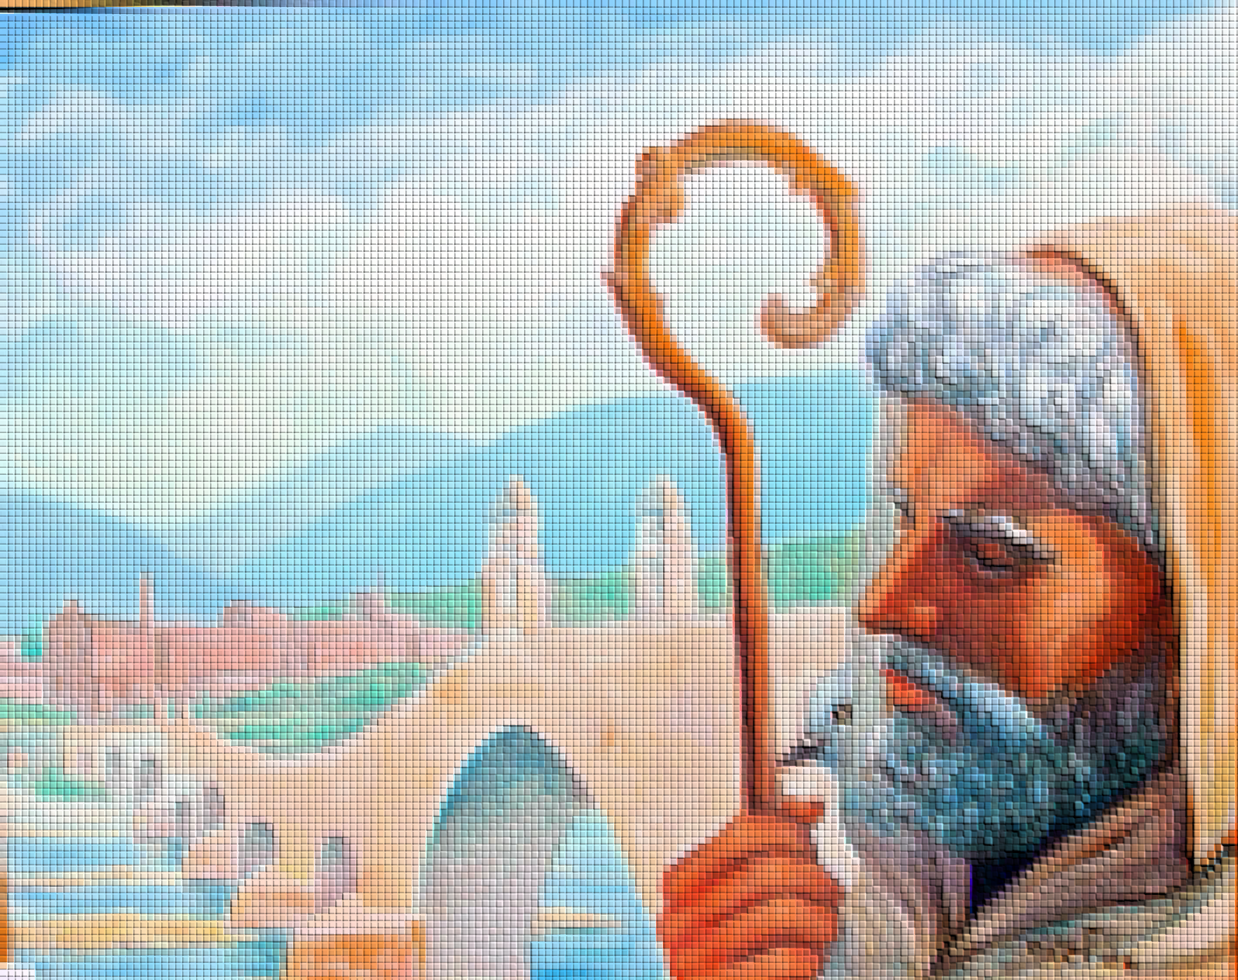
As a Christian, I am not without hope for the future. Inspired by the writings of Columban, I know that we can work together from within our rich and diverse traditions to celebrate and protect the diversity of species and protect planet earth.

Slide 36
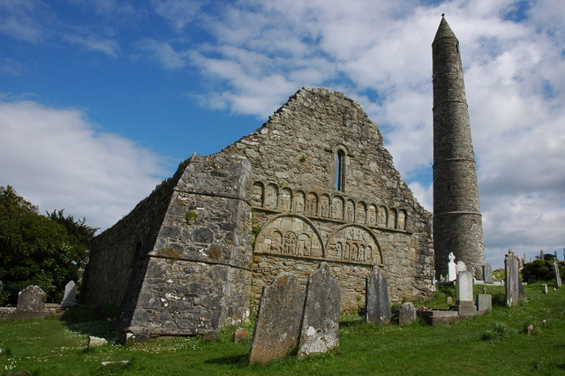

In the Gaelic that Columban would have spoken:
Ní Neart Go Cur Le Chéile –
There is strength in unity.

Slide 37
QUESTIONS FOR SMALL GROUPS:
As people who follow the vision of Columban, the Celtic love for nature, and heeding Pope Francis’ and many other scientists’ and religious leaders’ call for the protection of Planet Earth, what will I do
individually
in my community
in my nation
to “make a difference”?
“If you want to know the Creator, understand the Creation” - what do I need to learn/understand/change my behaviour in respect of, so that I can come closer to God in my brothers and sisters, as well as all the species that live together with us?

